Slide 1
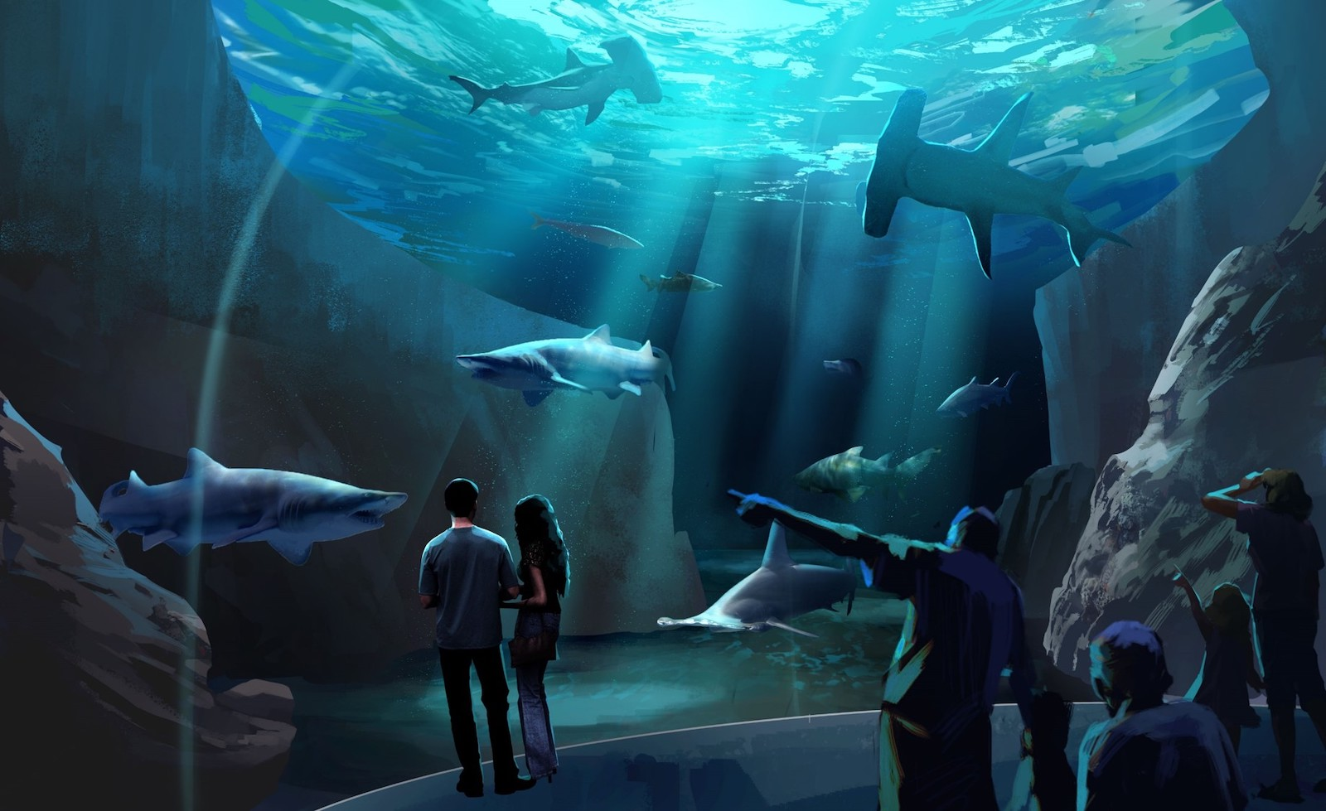
Shark Tank

Slide 2

Think About It
Ann, an aquarist who oversees the bull shark exhibit at the Oklahoma Aquarium, is going on vacation. The water in the shark tank evaporates a little bit each day.
If she is not there to add water, how long will it take for the shark tank to be too salty for the sharks?

Slide 3
Sketch a Graph
In your groups, work together to sketch a reasonable graph that models the salinity of the tank as water evaporates each day.

Slide 4
Explain your graph
For the graph that you drew, what do the independent and dependent variables represent?
Explain the shape of your graph in context.

Slide 5
If we were making an accurate graph, what data would we need?

Slide 6
Bull Shark Exhibit at the
Oklahoma Aquarium
Tank size: 380,000 gallons
Evaporation Rate/water loss: 4000 gallons per week
Salinity of the tank: maintain the salinity at 30 ppt. Bull sharks can live in fresh water and can tolerate salinities up to 35 ppt.

Slide 7
Salinity Computations
ppt means “parts per thousand” so a salinity of
30 ppt means 30 grams of salt per 1000 grams of salt water.
1mL of water weighs 1 gram

Slide 8
Find a function that models the salinity vs. number of days
How does the graph of your function compare to the graph you drew at first?
What is the meaning of the vertical asymptote?

Slide 9
