Slide 2
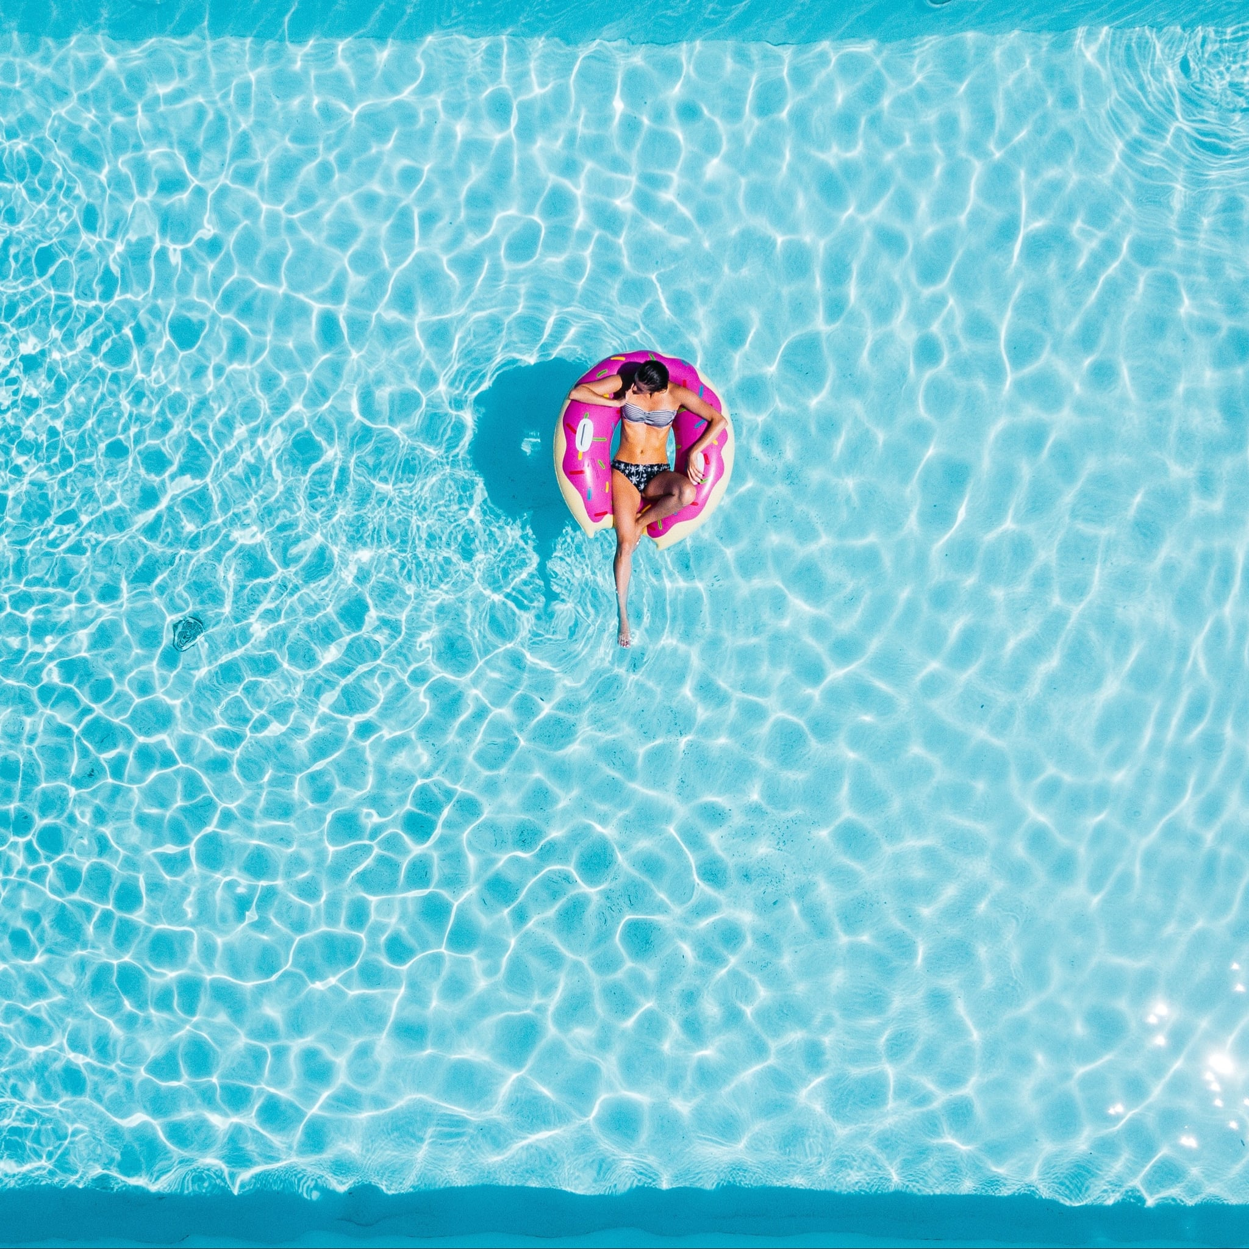
Construction on Ashley’s new pool is finally finished and she’s throwing a party tomorrow to celebrate. Can she fill the pool in time for the party?

Slide 3
What information do you need to know?

Slide 4
Dimensions
Rectangular sport pool
16 x 32 ft.
3 ft. deep on both ends
6 ft. deep in the center

Slide 5
Time & Water
There are currently 8000 gallons of water in the pool
24 hours until party

Slide 6
Play the video.
https://youtu.be/D2kwyPJyYPY
The bucket holds 5 gallons.

Slide 7
Time & Water
Ashley calls a local water tanker company to help fill the pool in time:
1 tank holds 9000 gal.
125 gal. per minute
$375 for full tank
$225 for half tank

Slide 8
Since tap water costs only $7 per 1000 gal, how can Ashley save the most money while filling the pool in time?
How much will it cost?
How long will it take?

Slide 9
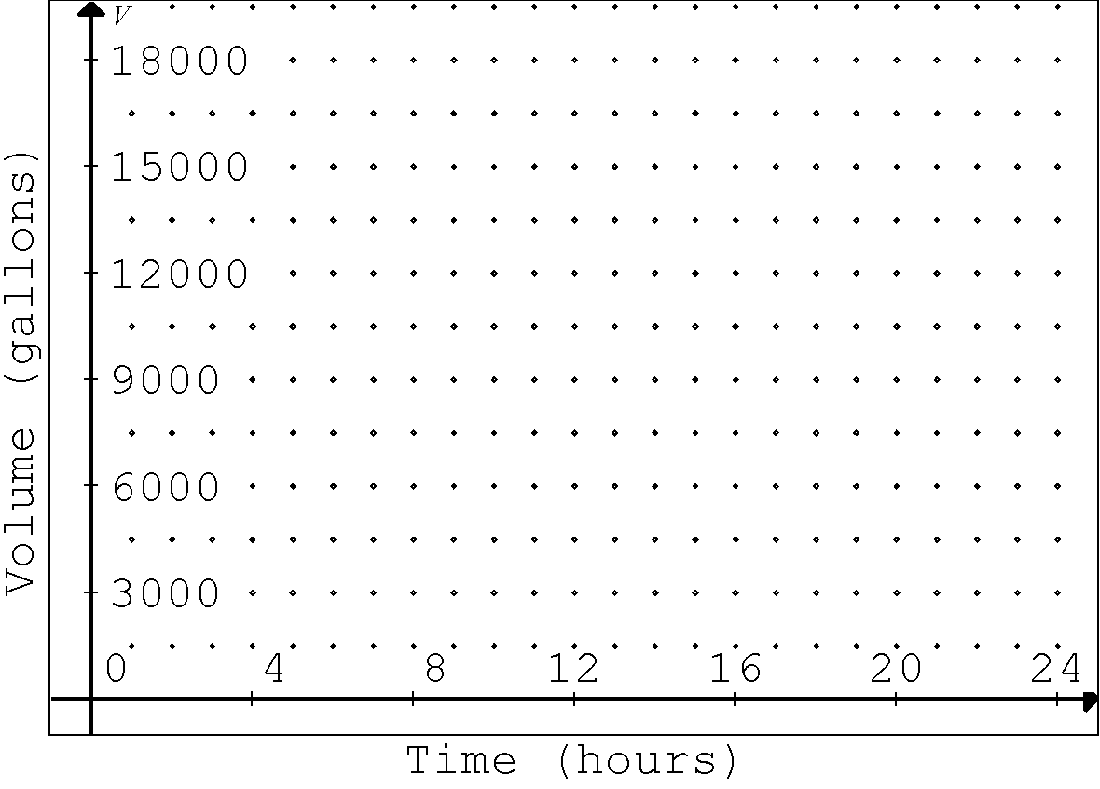
Sketch
the graph

