Slide 1
Piering Into Darkness
Tides and a Dramatic Rescue

Slide 2

Felix’s Plan
Mr. Fishoeder has refused to sell Wonder Wharf so that Felix can build condos.
Felix has a plan to get his way…
Watch the video: https://www.youtube.com/watch?v=5JuwjNy385o

Slide 3
Can They Be Saved?
How long do Bob and Mr. Fishoeder have before it’s too late?
What do we need to know in order to answer this question?

Slide 4
Consult the tide chart to estimate how long Bob and Mr. Fishoeder have left.

Slide 5
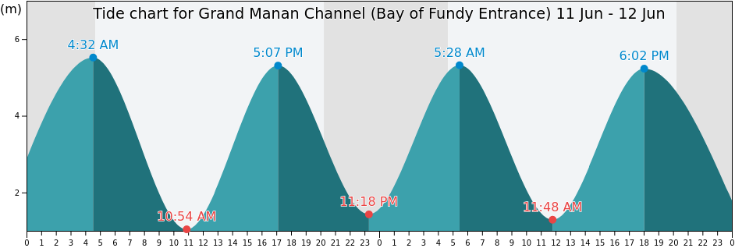
A Chart of the Tides (height in meters)
Seymour’s Bay, New Jersey

Slide 6
Ideal Situation
Suppose the high and low tides occur at twelve hour intervals.
Suppose also that the high tide is always 5.5m, or about 18ft.
Write a function that predicts the high tide given the time.

Slide 7
Saving the Day
Suppose Felix tied Bob and Mr. Fishoeder up at 11 AM on June 11th.
In order to make the rescue exciting, the camera will check back with them periodically as the water is rising.
When will the water be near their feet?

Slide 8
Saving the Day
The next time we see Bob and Mr. Fishoeder, the water is up to their waists.
When is that?

Slide 9
Saving the Day
In order to rescue the pair tied to the pier, the rest of the gang will need to get there BEFORE the water reached high tide.
When will the water be up to Bob and Mr. Fishoeder’s necks?

