Slide 1
Pace Yourself

Slide 2
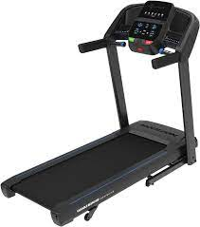
Think About It
Aaron runs on a treadmill that tracks his miles per hour.
He would really like to know his pace in minutes per mile.

Slide 3
Getting Started
If he runs at a speed of 6 miles per hour, what is his pace in minutes per mile?
If he runs at a faster speed, what will happen to his pace?

Slide 4
Graphing
In your groups, try to sketch the shape of a function that would convert Aaron’s speed (in MPH) to his pace (in minutes per mile).
Minutes per Mile
Miles per Hour

Slide 5
What will happen when Aaron runs very slow?
What is Aaron’s pace when he runs 1 mile per hour?
What about 0.5 miles per hour?
In your groups, make a conjecture about the y-intercept of the graph.
Based on your conjecture, modify your graph if needed.

Slide 6
What happens when Aaron runs very fast?
The fastest speed recorded by a human was the famous sprinter Usain Bolt, who clocked 27.8 mph in 2009. What was his pace in minutes per mile?
In your groups, make a conjecture about the x-intercept of the graph.
Based on your conjecture, modify your graph if needed.

Slide 7
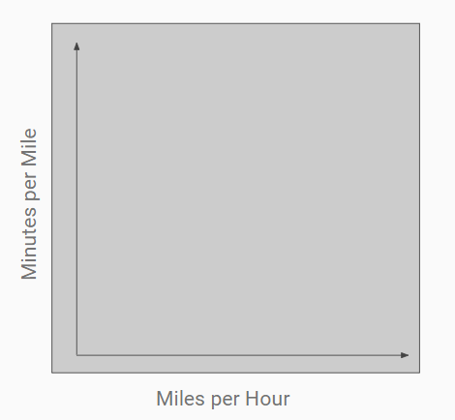
In your groups, write a function that models the situation. Draw a precise graph using the function.

Slide 8
Asymptotes
Does your graph have a vertical asymptote? Explain the meaning of the vertical asymptote in the context of Aaron’s speed and pace.
Does your graph have a horizontal asymptote? Explain the meaning of the horizontal asymptote in the context of Aaron’s speed and pace.

Slide 9
Concavity
In your groups, discuss the concavity of the graph you made.
Explain how the pace changes as the miles per hour increases, taking concavity into account.

