Slide 1
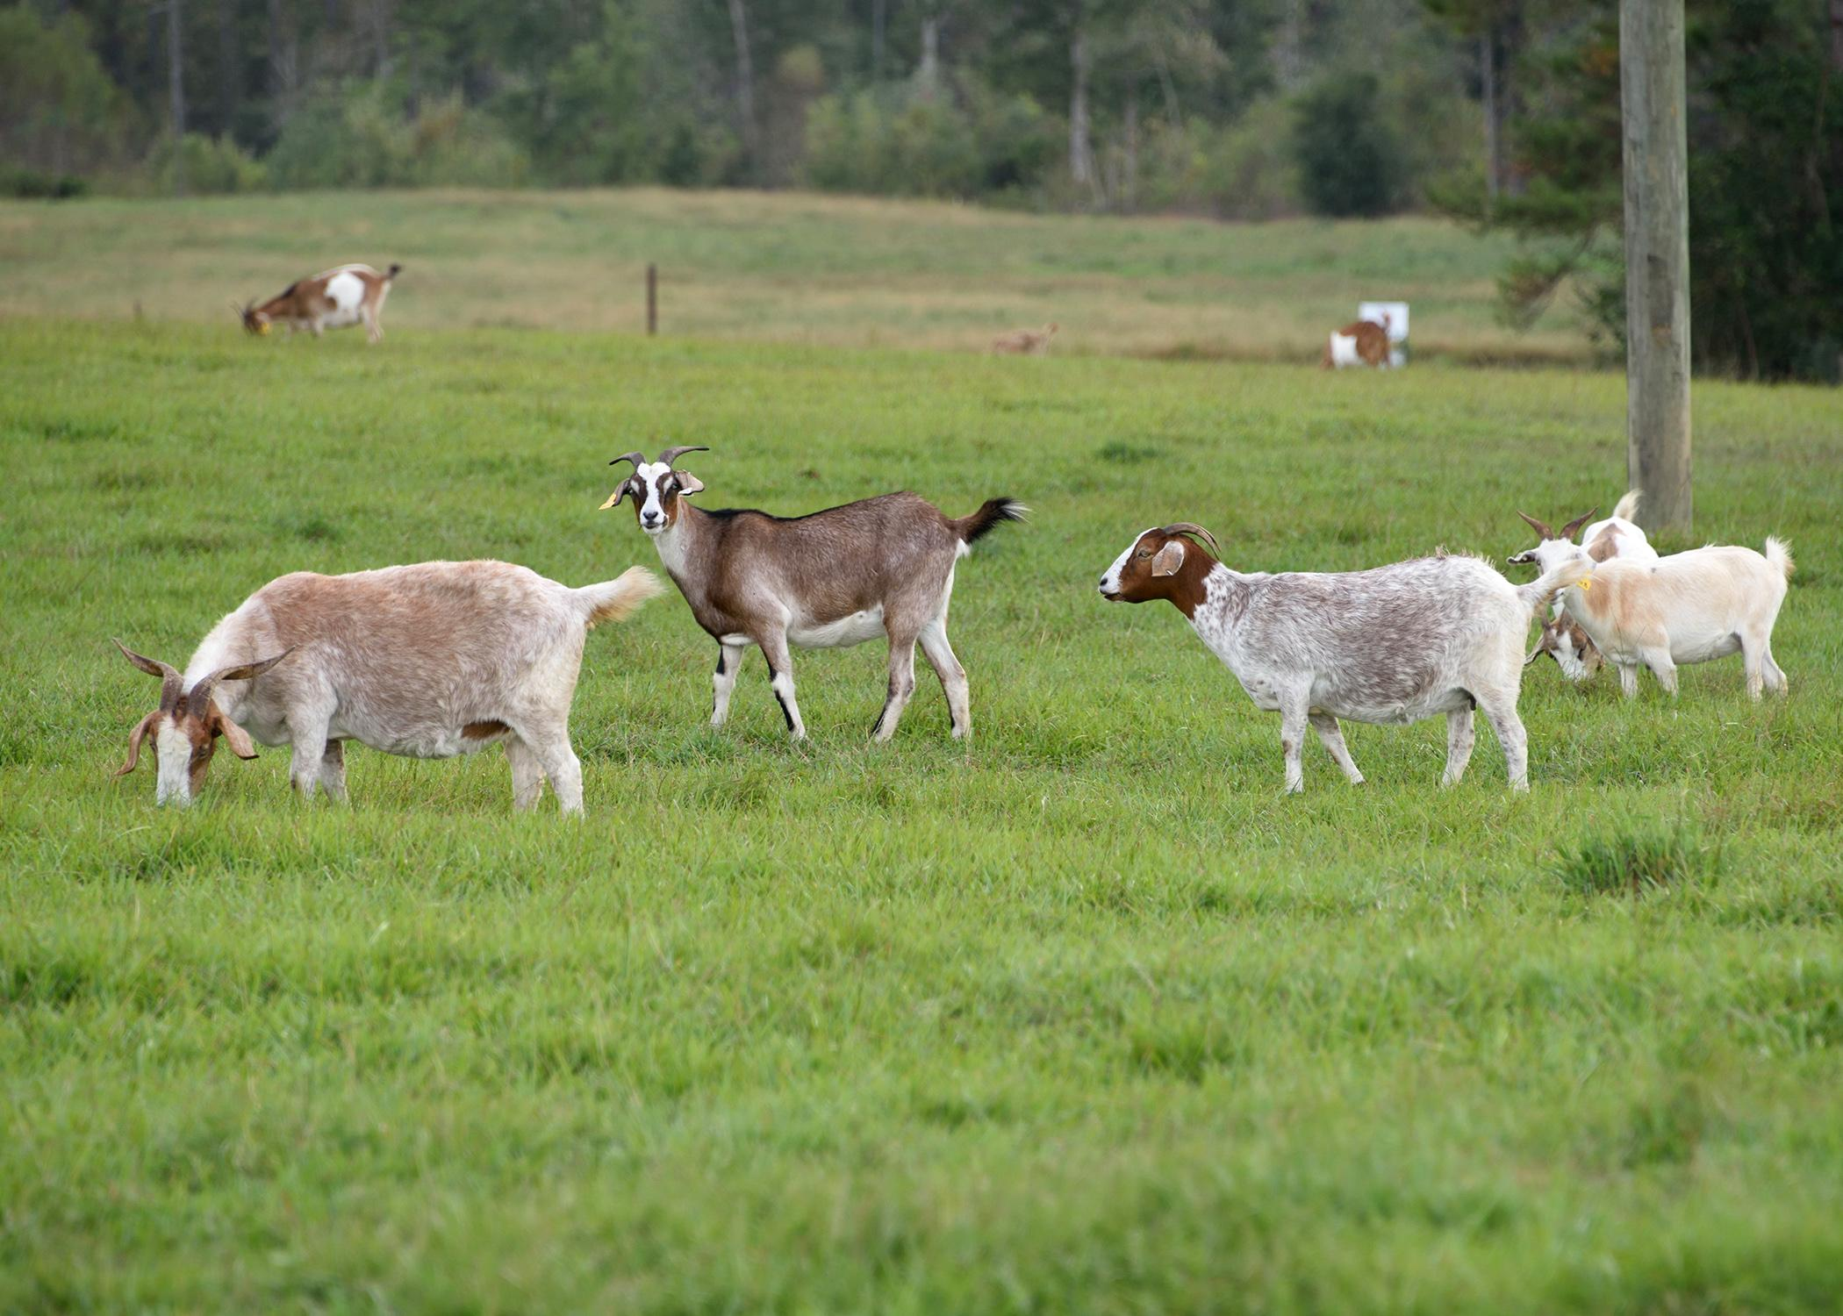
My First Goat Farm
Determining the Maximum Area

Slide 2
My First Goat Farm
You purchased a few acres of land and want to make a rectangular enclosure for goats using the neighbor’s fence as one side of the rectangle.

Slide 3
You have 792 feet of fencing to fence the 3 remaining sides.
If you begin with one side that is W feet long, what is the length L of your enclosure?
Neighbor’s Fence
W
L

Slide 4
Let’s consider several widths and lengths. Make a table to record them and compare their areas.
You want to give the largest area possible to your goats using your 792 feet of fencing. What dimensions will maximize the area?
Width (ft) | Length (ft) | Area (sq ft)
0 | 792 | 0
10 | 772 | 7,720

Slide 5
Plot your data points on coordinate axes using the width on the x-axis and the area on the y-axis.

Slide 6
Properties of the Graph
What are the x-intercepts for the graph? Discuss with other groups.
What is the maximum point for the graph? Discuss with other groups.
Where is the width (that maximizes the area) in relation to the x-intercepts?

Slide 7
Write a Formula
When using 792 feet of fencing, if the width is x, what is the length in terms of x?
What is the area in terms of x? Can you write it as a function, A(x)?

Slide 8
Maximizing the Area
Using the formula, can you find the dimensions that should be used to give the maximum area?

Slide 9
Suppose you have 1000 feet of fencing instead of 792 feet..
How does that change your solution?
Neighbor’s Fence
W
L

Slide 10
WHAT IF?
What if the neighbor’s fence is not sufficient to keeping the goats in, but he refuses to do the repairs? What changes would we need to make to the size of our goat farm.
What if we needed to subdivide the pens to make 3 (or 4 or 5) equal sized goat pens?

