Slide 1
Grandpa’s Statements
Mathematics and Finance

Slide 2
Scenario
While helping your Grandfather to organize his papers, you find three bank statements.
These are the only three that you can find among the piles of paper.

Slide 3
First Statement
Date | Note | Balance
10/1/1986 | Starting Balance | $725.13
10/31/1986 | Interest Earned | $2.42
10/31/1986 | Ending Balance | $727.55
The starting balance for October of 1986 was $725.13
The ending balance was $727.55

Slide 4
Second Statement
Date | Note | Balance
12/1/1990 | Starting Balance | $856.40
12/31/1990 | Interest Earned | $2.85
12/31/1990 | Ending Balance | $859.25
The starting balance for December of 1990 was $856.40
The ending balance was $859.25

Slide 5
Third Statement
Date | Note | Balance
6/1/2003 | Starting Balance | $1410.80
6/30/2003 | Interest Earned | $4.70
6/30/2003 | Ending Balance | $1415.50
The starting balance for June of 2003 was $1410.80
The ending balance was $1415.50

Slide 6
What do you need to know?
What information would you need to know to figure out how much is in the account today?

Slide 7
More information
Your grandpa said he remembers opening that account when he earned his first $250, but he can’t remember what year that was.
He hasn’t added to the account or made any withdrawals since it was opened.
The bank account is still open.

Slide 8
Plot the Balance
Horizontal Axis | Vertical Axis
Time | Balance
What should the scale be? | Place tick marks every _____
What other information would help us understand this?
Draw a graph that shows the balance in the account as a function of time.
Think about the best way to organize the information we have from the statements.

Slide 9
How much money is in the account today?

Slide 10
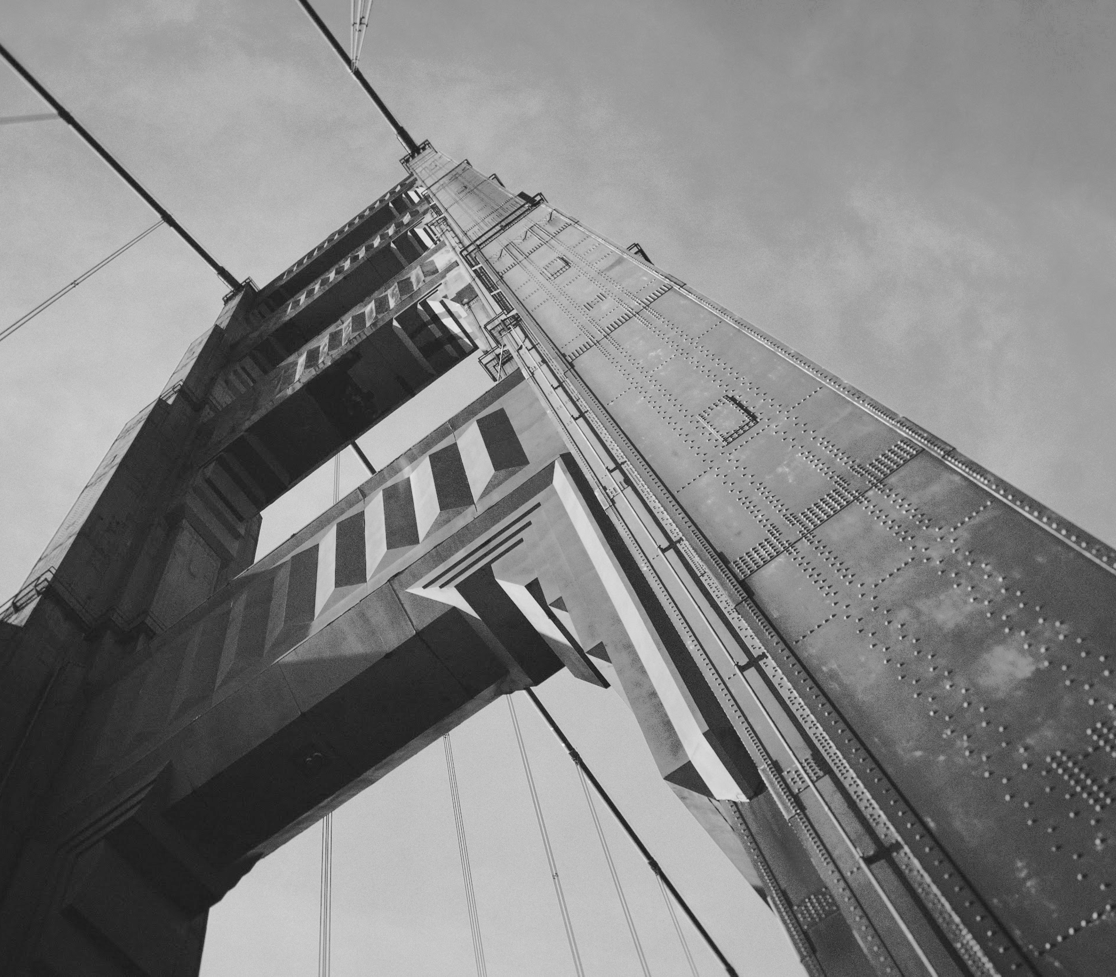
Beginnings
What year did grandpa open the account?

