Slide 1
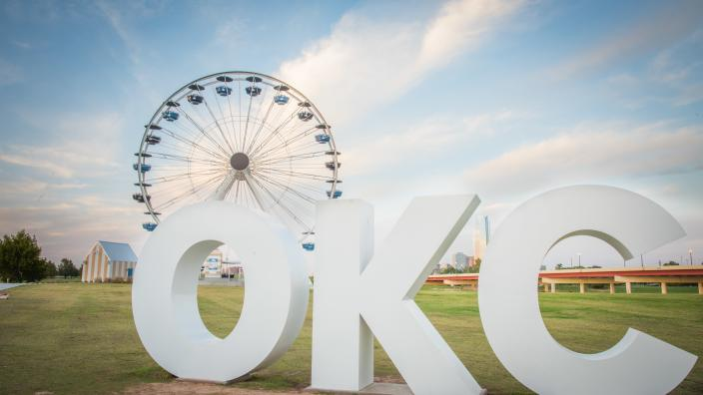
Ferris Wheel Frenzy

Slide 2
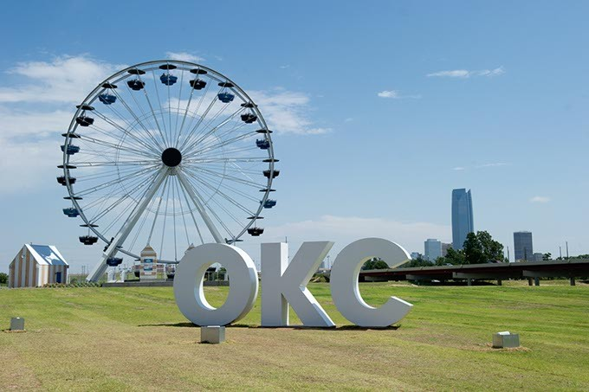
The Wheeler District, located near the Oklahoma River in Oklahoma City, debuted a new Ferris wheel in 2016.

Slide 3
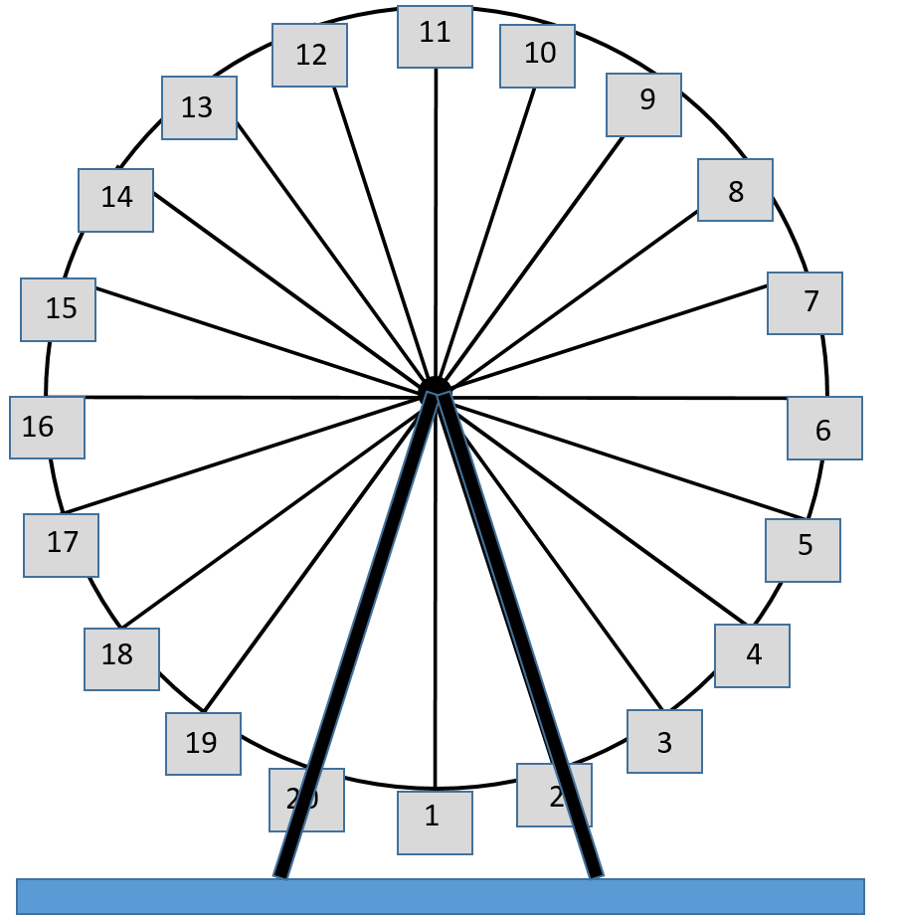
Radio station 90.5 FM is holding a promotion at the Wheeler Ferris wheel, giving away $905. After loading the Ferris wheel, each contestant will ride for exactly 90.5 minutes. Those who stop closest to a height of 90.5 feet win. Which gondola(s) wins?

Slide 4
What information do you need to know?

Slide 5
Assumptions
Wheel diameter is 90 feet
Lowest point is 8 feet above the ground
20 gondolas, evenly spaced
Riders randomly assigned a gondola
Height is measured from ground to gondola
From your viewing position, the wheel turns counterclockwise

Slide 6
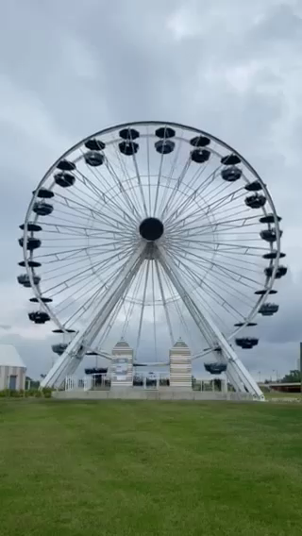
Play the video. What is the turning rate of the wheel?
https://youtu.be/FFhPoi4sJ9k

Slide 7
Make a graph for one period of gondola #1 by plotting the points where the carriage is lowest, highest, and halfway between the lowest and highest points. Label the times and heights.

Slide 8

Should you use sine or cosine to represent gondola #1?
$$y=Asin\left(B\left(x−h\right)\right)+k$$
or
$y=Acos\left(B\left(x−h\right)\right)+k$

Slide 9
How long does it take for a gondola to move to the position previously occupied by the gondola ahead of it?

Slide 10
Which gondola will win the prize?

