Slide 1
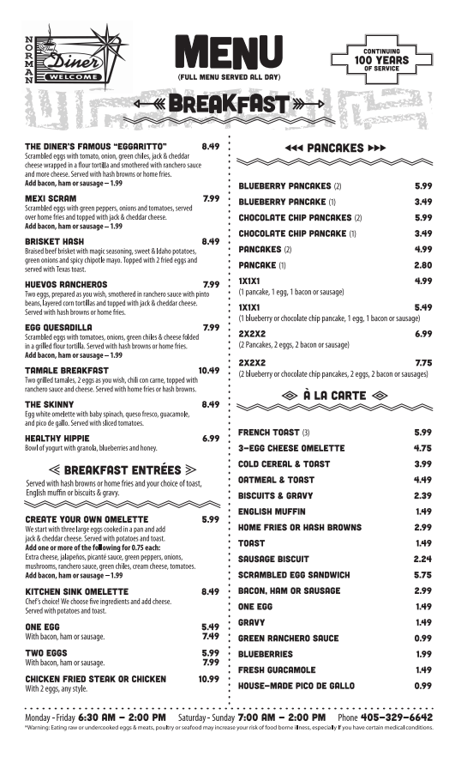
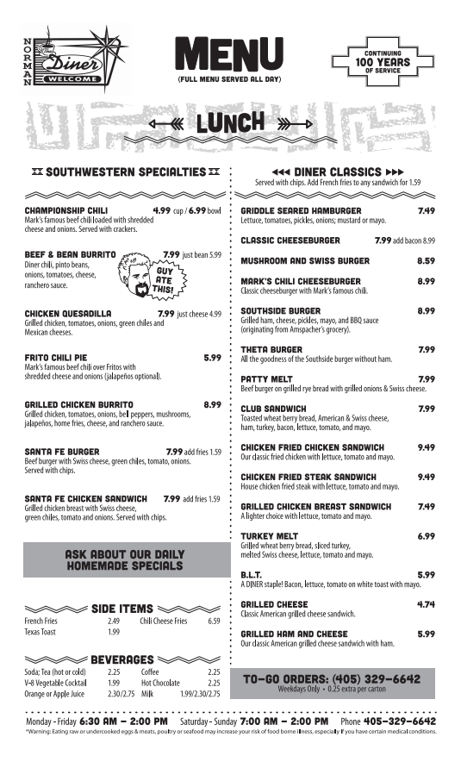
Dollhouse Diner
Melissa is surprising her daughter with a Barbie-sized replica of her favorite local diner. She wants to print menus for the diner.

Slide 2
Dollhouse Diner
1. How big should the replica menus be? Draw it.

Slide 3
Dollhouse Diner
1. How big should the replica menus be? Draw it.
2. Now be precise. How big should the menu be? Give dimensions in inches.

Slide 4
Dollhouse Diner
1. How big should the replica menus be? Draw it.
2. Now be precise. How big should the menu be? Give dimensions in inches.
The original diner menu is 8 x 10 inches.
The standard Barbie doll is 11.5 inches tall.
According to Wikipedia, if Barbie were an actual woman, she would be 5’9’’ tall.

Slide 5
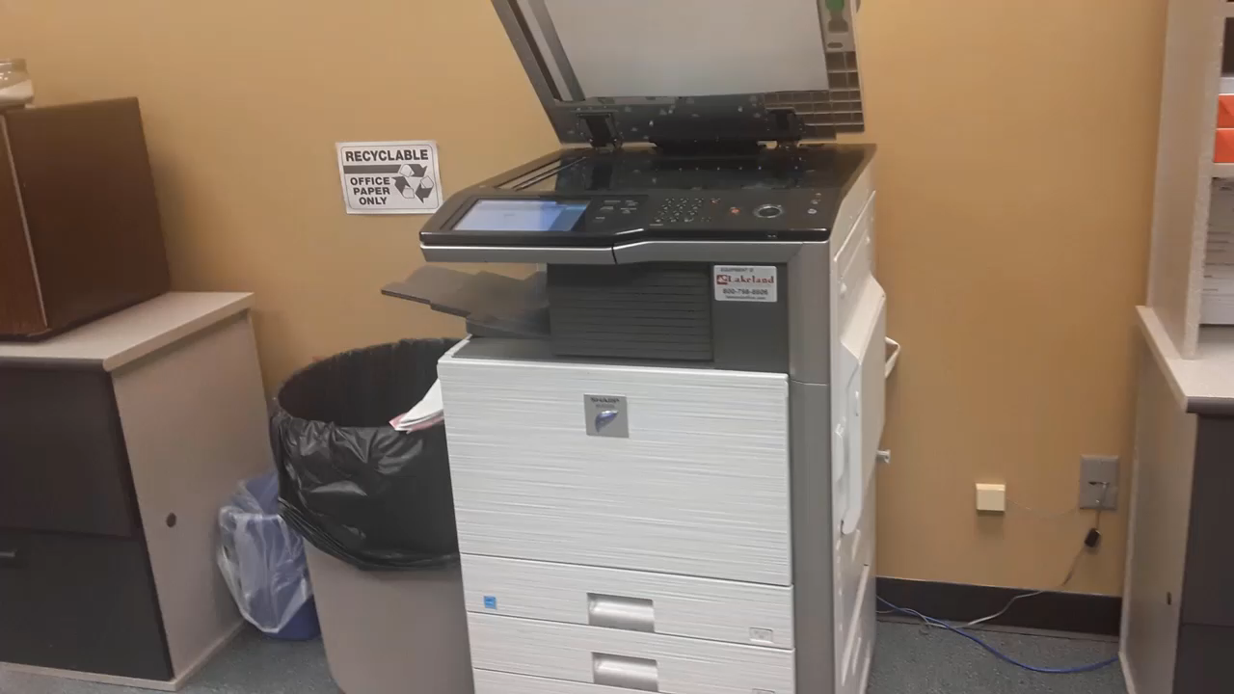
Dollhouse Diner
The copier she uses is broken and has only a
preprogrammed button that reduces images by an unknown fixed percentage.

Slide 6
Dollhouse Diner
How many times must she run the menu through the copy machine to get the best possible replica of the menu?
What information do you need to know?

Slide 7
Dollhouse Diner
How many times must she run the menu through the copy machine to get the best possible replica of the menu?
Draw the size of the menu after
each pass.
2. What are the final dimensions?

Slide 8
Dollhouse Diner: Follow-up Questions
How many times would Melissa have to copy the menu to make it effectively invisible?

Slide 9
Dollhouse Diner: Follow-up Questions
How many times would Melissa have to copy the menu to make it effectively invisible?
2. If Melissa wanted to expand this menu back up to normal size with exactly one copy, what percentage would she have to set the copier?

