Slide 1
Candle Conundrum

Slide 2
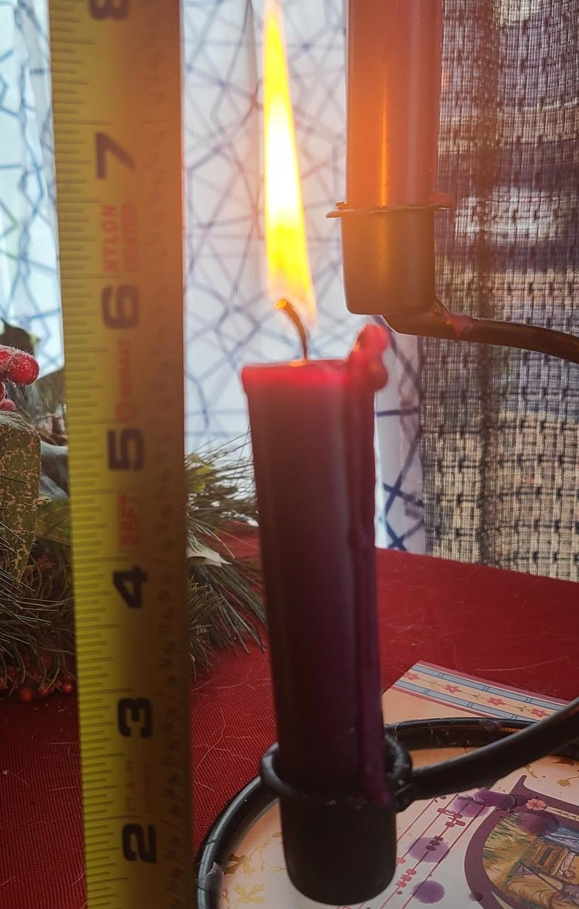
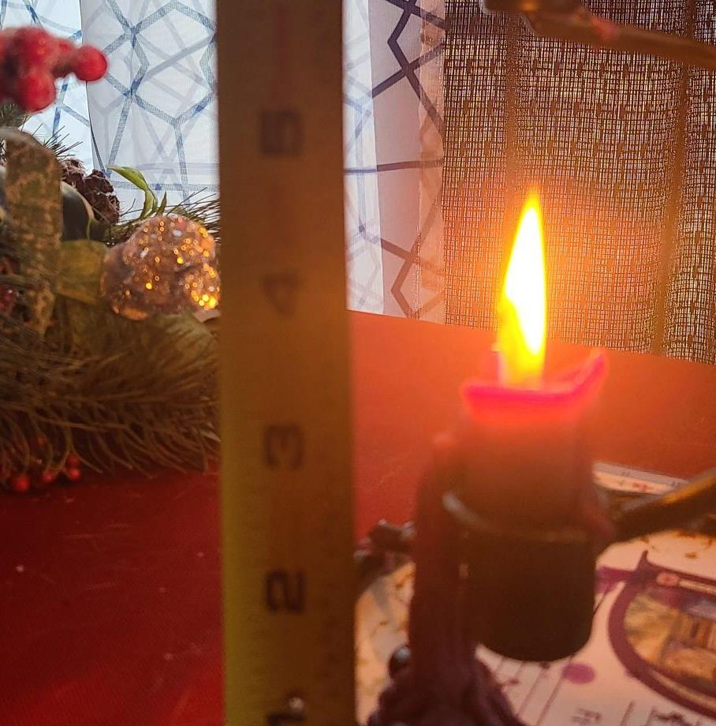
Context of the problem
One day, while visiting her grandmother’s house, Katherine saw a candle burning. It was already quite small. She measured the candle at 4:00pm and it was only 3 ½ inches long.
An hour later she measured it again and it was only 1 ¼ inches long.

Slide 3
Questions
Katherine wondered how much time (in minutes) is left before the candle burns out. In your groups, come up with your best estimate for when the candle will burn out.

Slide 4
Graph
In your group, sketch a graph of the given data.

Slide 5
Analyzing your graph
Does your graph have a horizontal intercept? What is the meaning of your horizontal intercept in terms of the candle?
Does your graph have a vertical intercept? What is the meaning of your vertical intercept in terms of the candle?

Slide 6
Making Predictions
The candle was 10 inches long when Katherine’s grandma bought it. At what time did she light the candle?

Slide 7
More Questions
What assumptions did we make about how the candle will burn to make our prediction?
Suppose that the candle is tapered, meaning that it is skinnier at the top than at the bottom. How would that change your prediction for when Katherine’s grandma lit the candle?

