Slide 1
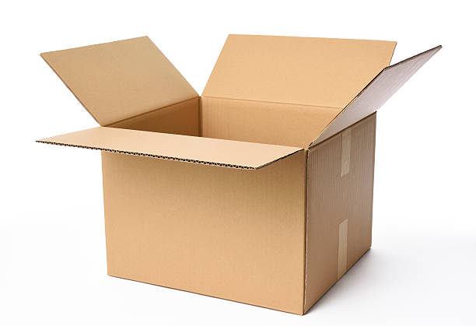
Boxing Match

Slide 2
Use your sheet of cardstock, scissors, tape, and ruler to create a box with an open top.

Slide 3
Now use your ruler to measure the length, width, and depth of your box.
Compute the volume of the box.
Talk to others in your group. How does the volume of your box compare to others’?

Slide 4
Now make another box by cutting out smaller squares. Calculate its volume. Will the volume be bigger or smaller?

Slide 5
Now make another box by cutting out larger squares. Calculate its volume. Will the volume be bigger or smaller?

Slide 6
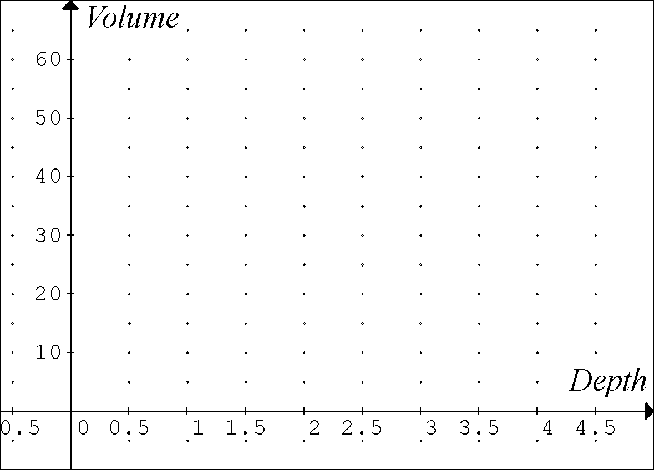
Report your depths and volumes. Discuss: How will the scatter plot will look?

Slide 7
Discuss: How are the side lengths of the square related to the length and width of the box? If the square has sides of length x, what are the length and width of the box?

Slide 8
Can you come up with a function that gives the volume of any box in your class as a function of the depth?

