Slide 1
The Limit Idea: Instantaneous Velocity
Make sure you can do the following on your graphing calculator:
Graph various functions.
Change the graphing window.
Zoom in/out around a given point on a graph.
Read coordinates of points on a graph.
Make a table for a function with a given domain increment.

Slide 2

The Limit Idea: Instantaneous Velocity
A bolt is fired from a crossbow straight up into the air* with an initial velocity of 49 m/s. Accounting for wind resistance proportional to the speed of the bolt, its height above the ground is given by the equation
meters (with t measured in seconds).
*Please don’t try this at home!
Notes:
Instructor Notes: Give students a moment to watch the animation. Ask what they notice about it. They might notice the changing speeds, the approximate maximum height etc.
Using this function derived from air resistance proportional to velocity results in a function slightly more complicated than a polynomial. Students that have previously had calculus are much more likely to push through working with a simple quadratic computationally without attending to the meanings developed in this sequence. Even if they can compute the derivative of this function, encourage them to set that aside in order to focus on ultimately being able to meaningfully interpret the results of such computations in the future.

Slide 3
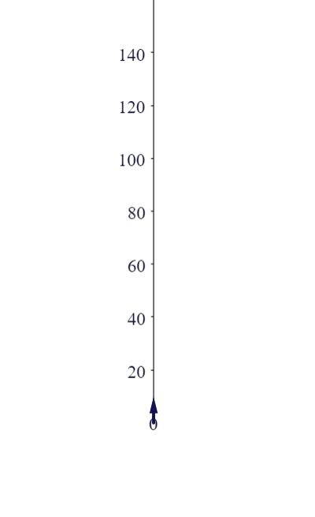

The Limit Idea: Instantaneous Velocity
A bolt is fired from a crossbow straight up into the air* with an initial velocity of 49 m/s. Accounting for wind resistance proportional to the speed of the bolt, its height above the ground is given by the equation
meters (with t measured in seconds).
*Please don’t try this at home!

Slide 4

The Limit Idea: Instantaneous Velocity
A bolt is fired from a crossbow straight up into the air* with an initial velocity of 49 m/s. Accounting for wind resistance proportional to the speed of the bolt, its height above the ground is given by the equation
meters (with t measured in seconds).
How fast is the
bolt traveling
at time t = 2
seconds?
*Please don’t try this at home!
Notes:
Instructor Notes: Let students know that we will develop an answer this question as a way to help us make sense of what is meant by an instantaneous speed.

Slide 5
The Limit Idea: Instantaneous Velocity
Draw the locations of the bolt at 1 second increments.
Compute the changes in height Δh corresponding to the changes in time
Δt = −1 s and Δt = 1 s
starting from t = 2 s.
Notes:
Instructor Notes: Give students time to create their own drawing, using their calculator to compute the various locations.
Show students how to use the function input and evaluation features of their calculators (or better, have them show each other)

Slide 6

The Limit Idea: Instantaneous Velocity
Draw the locations of the bolt at 1 second increments.
Compute the changes in height Δh corresponding to the changes in time
Δt = −1 s and Δt = 1 s
starting from t = 2 s.

Slide 7
The Limit Idea: Instantaneous Velocity
Draw the locations of the bolt at 1 second increments.
Compute the changes in height Δh corresponding to the changes in time
Δt = −1 s and Δt = 1 s
starting from t = 2 s.

Slide 8
The Limit Idea: Instantaneous Velocity
Draw the locations of the bolt at 1 second increments.
Compute the changes in height Δh corresponding to the changes in time
Δt = −1 s and Δt = 1 s
starting from t = 2 s.
Using this data, find an overestimate for the speed of the bolt at t = 2 s.
Notes:
Clicker Question (Numeric, 2 minutes)

Slide 9
The Limit Idea: Instantaneous Velocity
Draw the locations of the bolt at 1 second increments.
Compute the changes in height Δh corresponding to the changes in time
Δt = −1 s and Δt = 1 s
starting from t = 2 s.
Faster
Overestimate =
Using this data, find an overestimate for the speed of the bolt at t = 2 s.
Notes:
Clicker Question Answer: Encourage students to justify that this is an overestimate since the bolt is moving faster during the entire second prior to t = 2.

Slide 10
The Limit Idea: Instantaneous Velocity
Draw the locations of the bolt at 1 second increments.
Compute the changes in height Δh corresponding to the changes in time
Δt = −1 s and Δt = 1 s
starting from t = 2 s.
Using this data, find an underestimate for the speed of the bolt at t = 2 s.
Notes:
Clicker Question (Numeric, 1 minute)

Slide 11
The Limit Idea: Instantaneous Velocity
Slower
Draw the locations of the bolt at 1 second increments.
Compute the changes in height Δh corresponding to the changes in time
Δt = −1 s and Δt = 1 s
starting from t = 2 s.
Underestimate =
Using this data, find an underestimate for the speed of the bolt at t = 2 s.
Notes:
Clicker Question Answer: Encourage students to justify that this is an underestimate since the bolt is moving slower during the entire second after t = 2.

Slide 12
The Limit Idea: Instantaneous Velocity
Underestimate = average speed from t = 1 to t = 2: 21.04 m/s
Overestimate = average speed from t = 2 to t = 3: 31.897 m/s
Which do you think is the best option to find a more accurate approximation?
    Average the two values.
    Find the average speed over a longer period of time.
    Find the average speed over a shorter period of time.
Notes:
Instructor Notes: Many students will be tempted to argue that the average of the two approximations should be more accurate. Although that is true in this case, it is not always. The actual value can be anywhere in the interval between the best known under and over-estimates. If it is very near one of these it could be farther from the midpoint (average).
In general, given an underestimate and overestimate, it is usually best to report that possible range. Computing and reporting an average only loses information if we cannot tell if it is too big or too small.

Slide 13
The Limit Idea: Instantaneous Velocity
Overestimate = average speed from t = 1 to t = 2: 31.897 m/s
Underestimate = average speed from t = 2 to t = 3: 21.04 m/s
Which do you think is the best option to find a more accurate approximation?
    Average the two values.
    Find the average speed over a longer period of time.
    Find the average speed over a shorter period of time.
Notes:
Clicker Question (Multiple Choice, 1 minute)

Slide 14
The Limit Idea: Instantaneous Velocity
Draw the locations of the bolt at ½ second increments.
Compute the changes in height Δh corresponding to the changes in time
Δt = −½ s and Δt = ½ s
starting from t = 2 s.
Notes:
Instructor Notes: Although it may feel repetitive to have students repeat these computations for a smaller Δt, experiencing the process is helpful for students to develop a strong conceptual foundation for the limiting process.

Slide 15
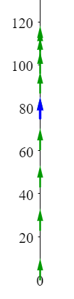
The Limit Idea: Instantaneous Velocity
Draw the locations of the bolt at ½ second increments.
Compute the changes in height Δh corresponding to the changes in time
Δt = −½ s and Δt = ½ s
starting from t = 2 s.

Slide 16
The Limit Idea: Instantaneous Velocity
Draw the locations of the bolt at 1 second increments.
Compute the changes in height Δh corresponding to the changes in time
Δt = −1 s and Δt = 1 s
starting from t = 2 s.

Slide 17
The Limit Idea: Instantaneous Velocity
Draw the locations of the bolt at 1 second increments.
Compute the changes in height Δh corresponding to the changes in time
Δt = −1 s and Δt = 1 s
starting from t = 2 s.
Using this data, find an overestimate for the speed of the bolt at t = 2 s.
Notes:
Clicker Question (Numeric, 1 minute)

Slide 18
The Limit Idea: Instantaneous Velocity
Draw the locations of the bolt at 1 second increments.
Compute the changes in height Δh corresponding to the changes in time
Δt = −1 s and Δt = 1 s
starting from t = 2 s.
Faster
Overestimate =
Using this data, find an overestimate for the speed of the bolt at t = 2 s.
Notes:
Clicker Question Answer

Slide 19
The Limit Idea: Instantaneous Velocity
Draw the locations of the bolt at 1 second increments.
Compute the changes in height Δh corresponding to the changes in time
Δt = −1 s and Δt = 1 s
starting from t = 2 s.
Using this data, find an underestimate for the speed of the bolt at t = 2 s.
Notes:
Clicker Question (Multiple Choice, 1 minute)

Slide 20
The Limit Idea: Instantaneous Velocity
Slower
Draw the locations of the bolt at 1 second increments.
Compute the changes in height Δh corresponding to the changes in time
Δt = −1 s and Δt = 1 s
starting from t = 2 s.
Underestimate =
Using this data, find an underestimate for the speed of the bolt at t = 2 s.
Notes:
Clicker Question Answer

Slide 21
The Limit Idea: Instantaneous Velocity
Error < 5.428 m/s
Using this same approach, find an approximation for the speed of the bolt at time t = 2 s accurate within 0.1 m/s.
Notes:
Clicker Question (Numeric, 1 minute)

Slide 22
The Limit Idea: Instantaneous Velocity
Try
Overestimate:
Error < 0.11 m/s
Underestimate:
→ not quite good enough
(but will accept either for now)
Using this same approach, find an approximation for the speed of the bolt at time t = 2 s accurate within 0.1 m/s.
Notes:
Instructor Notes: Students may make attempts and obtain a final answer with different Δt-values

Slide 23

The Limit Idea: Instantaneous Velocity
Try
Overestimate:
Error < 0.054 m/s
Underestimate:
Will accept answers between 26.3 and 26.5 m/s
Using this same approach, find an approximation for the speed of the bolt at time t = 2 s accurate within 0.1 m/s.
Notes:
Instructor Notes: It is particularly important to accept a range of answers since students may have used different Δt-values

Slide 24
The Limit Idea: Instantaneous Velocity
Which of the following gives the change in height of the bolt Δh
starting at time t = 2 seconds for a duration of Δt seconds?
Notes:
Clicker Question (Multiple Choice, 1 minute): This question is aimed at supporting students to make sense of function notation and the various elements of the difference quotient

Slide 25
The Limit Idea: Instantaneous Velocity
Which of the following gives the change in height of the bolt Δh
starting at time t = 2 seconds for a duration of Δt seconds?
Notes:
Clicker Question Answer

Slide 26
The Limit Idea: Instantaneous Velocity
Which of the following gives the average speed of the bolt
from time t = 2 seconds for a duration of Δt seconds?
Notes:
Clicker Question (Multiple Choice, 1 minute)

Slide 27
The Limit Idea: Instantaneous Velocity
Which of the following gives the average speed of the bolt
from time t = 2 seconds for a duration of Δt seconds?
Notes:
Clicker Question Answer

Slide 28
The Limit Idea: Limit Notation
Instantaneous speed of the bolt 2 seconds after it was fired:
Error = | unknown – approximation | < error bound
We can make the approximations as accurate as we like by making the controlling variable close to the singularity.
approximations
(average speeds)
unknown
controlling variable
singularity
Notes:
Instructor Notes: We will use the limit notation to refer to quantities derived from these types of approximation processes. For students that have previously had calculus but approached limits computationally or mor informally, emphasize that this is finally a way to understand what limits really mean.
Note that the logic of these relationships is exactly the logic of the formal ε-δ definition, just without the formality. Thus conveying that this is the meaning of limits does not sacrifice rigor.

Slide 29
The Limit Idea: Limit Notation
Instantaneous rate of change of a function at the point x:
Error = | unknown – approximation | < error bound
We can make the approximations as accurate as we like by making the controlling variable close to the singularity.
approximations
(average rates)
unknown
Difference Quotient
controlling variable
singularity
Notes:
Instructor Notes: This repeats the previous notation, but for an arbitrary function, the independent variable x, and an arbitrary starting point for that x.

Slide 30
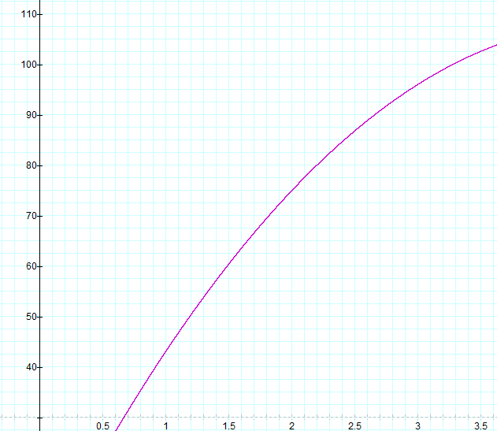
The Limit Idea: Graphical interpretation
Which of the following represents the change in height of the bolt
from time t = 2 sec for a duration of Δt = 1 sec?
C
  The length of segment A
  The length of segment B
  The slope of line C
  The slope of line D
B
A
D
Notes:
Clicker Question (Multiple Choice, 1 minute): We have delayed graphical interpretations to avoid students from drawing too heavily on a non-quantitative meaning of slope as “steepness.”
In these slides, continually connect the graphical interpretations to the ideas of average and instantaneous speed developed in the earlier parts of this unit.

Slide 31
The Limit Idea: Graphical interpretation
Which of the following represents the change in height of the bolt
from time t = 2 sec for a duration of Δt = 1 sec?
C
  The length of segment A
  The length of segment B
  The slope of line C
  The slope of line D
B
A
D
Notes:
Clicker Question Answer

Slide 32
The Limit Idea: Graphical interpretation
Which of the following represents the average speed of the bolt
from time t = 2 sec for a duration of Δt = 1 sec?
C
  The length of segment A
  The length of segment B
  The slope of line C
  The slope of line D
B
A
D
Notes:
Clicker Question (Multiple Choice, 1 minute)

Slide 33
The Limit Idea: Graphical interpretation
Which of the following represents the average speed of the bolt
from time t = 2 sec for a duration of Δt = 1 sec?
C
  The length of segment A
  The length of segment B
  The slope of line C
  The slope of line D
B
A
D
Notes:
Clicker Question Answer

Slide 34
The Limit Idea: Graphical interpretation
Instantaneous rate of change of a function at the point x:
slope = instantaneous rate

