Slide 1
Chort and Frey ran a marathon (26.2 miles).
  Chort ran at a perfectly uniform pace of eight-minutes-per-mile.
  Frey took exactly eight minutes and one second to complete each one-mile interval. This refers to all one-mile intervals, including, for example, the interval from 5.63 miles to 6.63 miles.
Frey won. How?
Notes:
Instructor Notes: This question should reveal that there are subtle issues to explore with something as seemingly simple and thoroughly covered in previous learning as constant rate of change.
You may need to clarify for students that this is not a trick question, for example Frey did not have a head start, etc.
The key here is that Frey is not required to run at a constant speed. The statement that every mile “took exactly eight minutes and one second” is only a statement about those particular distances and times. It does not imply that shorter distance and time intervals will scale proportionally. An example of a graph with such variable speed is provided in the virtual manipulatives: https://clearcalculus.okstate.edu/150-functions-marathon-paradox
This revelation is intended to be used to encourage students to reason more robustly about the proportional relationship involved in this and other constant rate scenarios.

Slide 2
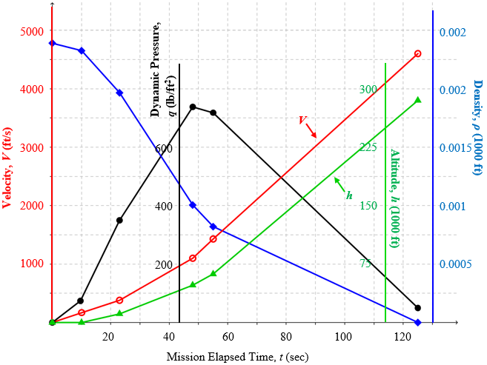
Constant and average rate of change: NASA launch data
Pick a point on the Velocity graph.
Explain its meaning.
Notes:
Instructor Notes: Students are likely to say things similar to the reasoning on the subsequent slides. Don’t focus on critiquing or correcting ideas at this stage, but encourage questions and consideration of complications.
The goal here is to help students realize that, much like the subtleties revealed by the marathon paradox in the previous slide, understanding what an instantaneous rate means quantitatively will require some work. Point out that doing so carefully and then being able to apply those meanings usefully is the goal of much of the first part of the course. We first need to set that up with a careful examination of the quantitative meanings of constant and average rates.

Slide 3
Constant and average rate of change: NASA launch data
Pick two points on the Altitude graph.
Compute the average speed between them.
Explain the meaning of your answer.
Notes:
Instructor Notes: Assume that the rocket travels straight up. Thus the altitude is also the distance traveled.
Most students will know how to perform this computation but struggle to convey what it means. Encourage students’ questions and consideration of complications. These will be addressed in subsequent slides.

Slide 4
Constant and average rate of change: NASA launch data
Use the altitude graph to find the average speed of the rocket between the 5th and 6th data points.
Notes:
Instructor Notes: Clicker Question
Emphasize the meaning of changes in quantities as measurements in their own right, e.g., 70 seconds is not just a computational difference of two times, it also represents the amount of time elapsed during which the rocket travels the corresponding distance.

Slide 5
Constant and average rate of change: NASA launch data
What does it mean to say:
“The instantaneous
speed of the rocket
is 4600 ft/s”?
Critique:
“The rocket’s speedometer is pointing at 4600.”
Notes:
Instructor Notes: Note that naming the instrument that measures a quantity doesn’t tell you what it means. You would need to know something about how it works. This can be made more salient to students by asking if “The transducer is pointing at 733” is a helpful explanation of what the maximum dynamic pressure of 733 lb/ft² means.
Encourage students to wrestle with the fact that “instantaneous speed” seems to refer to an instant of time lasting 0 seconds in which the rocket travels 0 feet.

Slide 6
Constant and average rate of change: NASA launch data
What does it mean to say:
“The instantaneous
speed of the rocket
is 4600 ft/s”?
Critique:
“The rocket travels 4600 feet every second.”
Notes:
Instructor Notes: We don’t know that the rocket is traveling at a constant speed, in fact it seems it is probably still accelerating at this time. Thus in almost any one second interval of time the rocket probably does not travel 4600 ft.
Encourage students to wrestle with the fact that “instantaneous speed” seems to refer to an instant of time lasting 0 seconds in which the rocket travels 0 feet.

Slide 7
Definitions
Constant and average rate of change: NASA launch data
Constant
Rate
Average
Rate
Instantaneous
Rate
Notes:
Instructor Notes: This lays out how we will approach the definitions. We will first define constant rate. Then the meaning of constant rate can be used to define average rate. Finally, we will eventually develop a robust quantitative meaning for instantaneous rate that resolves all of the difficulties of no motion occurring in an instant with no duration.

Slide 8
Constant and average rate of change: NASA launch data
What does it mean to say:
“The rocket is traveling at a constant speed of 7200 ft/s”?
Critique:
“The instantaneous speed is a constant 7200 ft/s (it’s not changing).”
Critique:
“There is no acceleration.”
Critique:
“The rocket travels 7200 feet every second.”
Notes:
Instructor Notes: Elicit students’ critiques to these statements one at a time. Treat this as brainstorming where all ideas can be expressed. Some possible critiques to draw out are:
For “The instantaneous speed is a constant 7200 ft/s (it’s not changing),” we’ve already recognized that instantaneous speed is a problematic term, so using that in our definition doesn’t help. We will eventually define instantaneous speed based on what we mean by constant and average speed. So we can’t use it here, otherwise we would have a circular definition.
For “There is no acceleration,” this is just another way to say the instantaneous speed is constant.
For “The rocket travels 7200 feet every second,” this is subtle, but remind students of the marathon paradox. Traveling 7200 fee every second would not necessarily require a constant speed since there could be variation within each second.

Slide 9
Constant and average rate of change: NASA launch data
What does it mean to say:
“The rocket is traveling at a constant speed of 7200 ft/s”
If you fix a duration of time, what can you say about the distance traveled during any time interval of that duration?
  The change in distance is always the same.
  The change in distance (in ft.) is always 7200 times the duration (in s.)
What if you triple that duration of time?
  The change in distance will also triple.
What if you cut the duration in half?
  The change in distance will also halve.
∆D is a constant multiple of ∆t
∆D and ∆t scale by the same factor
Notes:
Instructor Notes: This should lead students to start to reason proportionally about constant speed. This is the key distinction about constant rate that resolves the marathon paradox.

Slide 10
Constant and average rate of change: NASA launch data
What does it mean to say:
“The rocket is traveling at a constant speed of 7200 ft/s”?
How far will the rocket travel in 1 second?
7200 ft
3 seconds?
7200 ft/s × 3 s = 21,600 ft
½ second?
7200 ft/s × ½ s = 3600 ft
∆D is a constant multiple of ∆t
∆D and ∆t are proportional
∆D and ∆t scale by the same factor
Notes:
Clicker Questions (Numeric, 30 seconds each): Most students will be able to answer these. Doing so can help keep students engaged, and actually enacting the proportional calculations is helpful to reinforce the concept of proportionality. The (slight) repetition helps reinforce this relationship holds for any scaling.

Slide 11
Constant and average rate of change: NASA launch data
Meaning of constant rate (reminder)
y changes at a constant rate with respect to x means
their changes are proportional
Δy = k Δx
Notes:
Instructor Notes: Remind students of the meaning of constant rate in terms of the proportional relationship between changes in the quantities.

Slide 12
Constant and average rate of change: NASA launch data
What does it mean to say:
“The rocket is traveling at a constant speed of 7200 ft/s”?
Write a formula relating Δh and Δt
(with height represented by h in feet
and time since launch represented by t in seconds)
Δh = 7200 Δt
Notes:
Instructor Notes: This draws out another important meaning for proportionality. Specifically, Δh being proportional to Δt implies that Δh is always some constant multiple of the corresponding Δt, no matter where those differences are measured or how big or small they are. The constant of proportionality is the rate of change measured in the appropriate units.

Slide 13
Constant and average rate of change: NASA launch data
Use the altitude graph to find the average speed of the rocket between the 5th and 6th data points.
Notes:
Instructor Notes: Clicker Question
We now shift to focusing on the meaning of average rate of change. Again we begin with a calculation that most students can perform, then question what the resulting quantity actually measures.

Slide 14
Constant and average rate of change: NASA launch data
What does it mean to say:
“The average speed of
the rocket is 3186 ft/s”?
Critique:
“The average of all the rocket’s speeds is 3186 ft/s.”
Critique:
“The rocket travels 3186 ft/s most of the time.”
Notes:
Instructor Notes: Some possible critiques:
For “The average of all the rocket’s speeds is 3186 ft/s,” the rocket travels an infinite number of different speeds. We couldn’t compute an average by adding them all up then dividing by infinity.
For “The rocket travels 3186 ft/s most of the time,” this is almost certainly not true. Most likely the rocket is speeding up this entire time and only travels exactly 3186 for an instant, while it travels many other speeds the entire rest of the time.

Slide 15
Constant and average rate of change: NASA launch data
Imagine that another rocket WAS traveling at a constant speed of 3186 ft/s.
What would happen if the two rockets were launched at the same time?
Notes:
Instructor Notes: This sets up the fundamental meaning of an average rate as a constant rate for an auxiliary (possibly imaginary) situation.

Slide 16
Constant and average rate of change: NASA launch data
Meaning of average rate
  There is some alternate scenario (possibly imaginary)
  with a constant rate
  with the same changes in both quantities Δy and Δx
Notes:
Instructor Notes: Remind students of the meaning of average rate in terms of a constant rate for an alternate scenario with the same changes in both quantities.

Slide 17
Constant and average rate of change: NASA launch data
Meaning of constant rate (reminder)
y changes at a constant rate with respect to x means
their changes are proportional
Δy = k Δx
Notes:
Instructor Notes: Remind students of the meaning of constant rate in terms of the proportional relationship between changes in the quantities.

Slide 18
Constant and average rate of change: NASA launch data
Make sure you can do the following on your graphing calculator:
Graph various functions.
Change the graphing window.
Zoom in/out around a given point on a graph.
Read coordinates of points on a graph.
Make a table for a function with a given domain increment.

