Slide 1
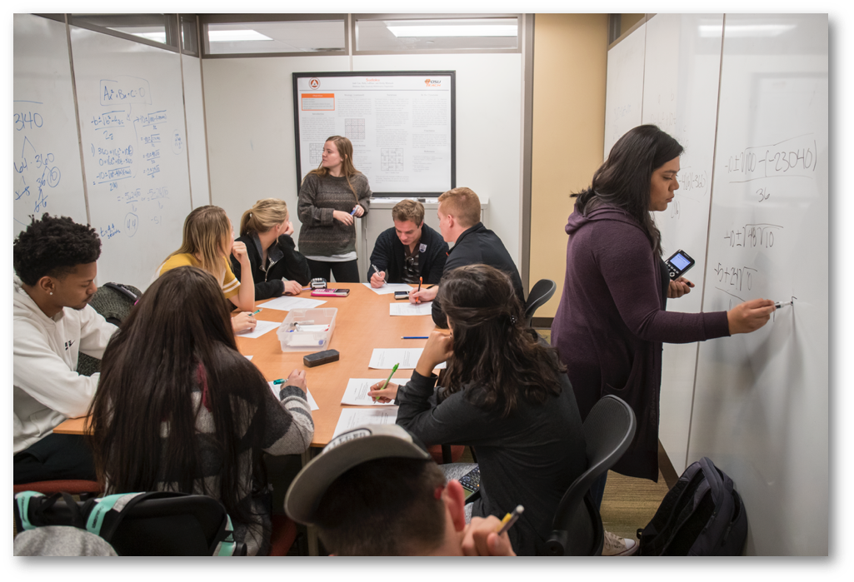
What is Functions and Modeling? Who are its students?
Notes:
AD

Slide 2

Overview
Who are the students?
State student learning outcomes and pathways
Placement
Examples of how Functions is being taught
Resources and technology
Content coverage
Real world contexts in multiple representations
Active learning
Making a complete model
Summary and discussion
Notes:
AD

Slide 3
Where did Functions come from?
State standards and pathways
Notes:
AB

Slide 4
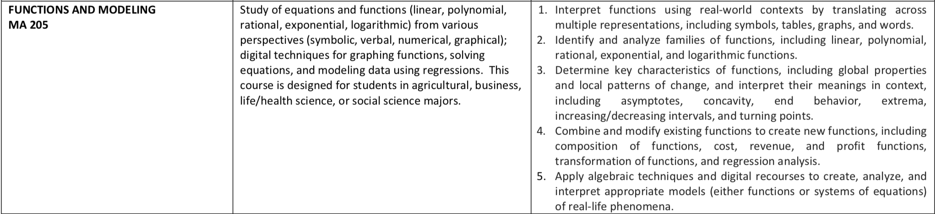
State Standards
What stands out to us: Functions and Modeling is NOT college algebra. Some critical differences:
Real world contexts
Technology over algebraic manipulations enables focus on concepts (over, for example, procedures)
Notes:
AB

Slide 5
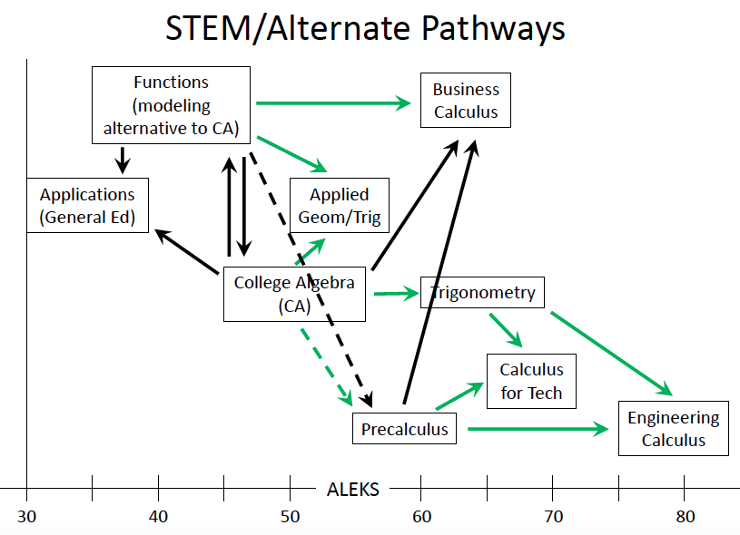
Notes:
AD

Slide 6
Examples of how Functions is currently being implemented

Slide 7
Class setup and prerequisites
 | OU | OSU
Placement | C in DMAT or assessment | Regular: 35 or better on ALEKS CoReq: 25 to 34 on ALEKS
Meeting days | MWF, TR, or MW | Regular - MWF (or T/Th) Coreq - MTWRF
Notes:
AB/AD

Slide 8
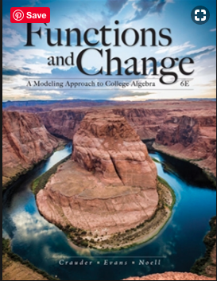
Resources and Technology
OU | OSU
Crauder, B., Evans, B., & Noell, A. (2013). Functions and Change: A Modeling Approach to College Algebra. Cengage Learning. (5th edition) | Crauder, B., Evans, B., & Noell, A. (2013). Functions and Change: A Modeling Approach to College Algebra. Cengage Learning. (6th edition)
TI-83 or TI-84 | TI-83 or TI-84
OU workbook | Cook, J.P. (2016). Inquiry-based nstructional Materials for Co-requisite Sections of Mathematical Functions and Their Uses. Available at http://bit.ly/2WOA8gI.
Notes:
AB/AD

Slide 9
OU Material (2018-2019 school year)
1.1 Functions Given by Formulas
1.2 Functions Given by Tables
1.3 Functions Given by Graphs
1.4 Functions Given by Words
1.5 Graphing
1.6 Limits to Infinity
1.7 Solving Linear Equations
1.8 Solving Nonlinear Equations
1.9 Inequalities
1.10 Systems of Equations
2.1 Function Transformations
2.2 Composition of Functions
2.3 Inverse Functions
2.4 Lines
2.5 Linear Functions
2.6 Linear Regression
3.1 Exponential Growth and Decay
3.2 Exponential Applications
3.3 Exponential Regression
3.4 Logarithmic Functions
3.5 Exponential and Logarithmic Equations
3.6 Logistic Functions
4.1 Polynomial and Rational Functions
4.2 Right Triangle Trigonometry
Notes:
AB

Slide 10
OSU material
1.1 Functions given by formulas ​
1.2 Functions given by tables ​
1.3 Functions given by graphs ​
1.4 Functions given by words ​
2.1 Tables and trends ​
2.2 Graphs ​
2.3 Solving linear equations ​
2.4 Solving nonlinear equations ​
2.5 Inequalities ​
2.6 Optimization ​
3.1 The geometry of lines ​
3.2 Linear functions ​
3.5 Systems of equations ​
4.1 Exponential growth and decay ​
4.2 Constant percentage change
4.5 Logarithmic functions ​
3.3 Modeling data w/ linear functions ​
3.4 Linear regression ​
4.3 Modeling exponential data ​
4.4 Modeling nearly exponential data ​
6.1 Velocity ​
6.2 Rates of change of other functions ​
6.4 Equations of change ​
5.1 Logistic functions ​
5.4 Quadratic functions ​
Notes:
AD

Slide 11
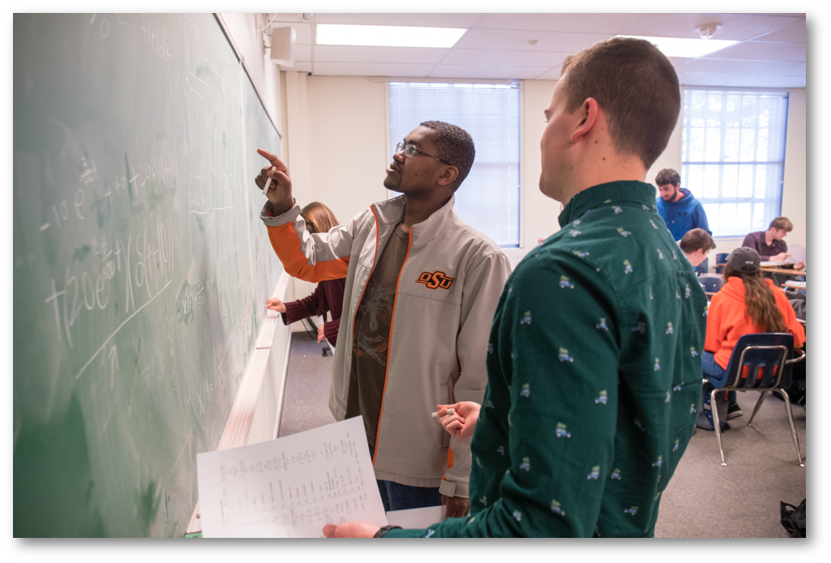
Making a complete model
THE BIG 5: When working with a function, always …
(1) … identify each of the quantities involved,
(2) … identify the units being used to measure these quantities.
(3) … define a variable to represent each quantity,
(4) … classify each as an input or output quantity, and
(5) … express the relationship in function notation.
Notes:
AD

Slide 12
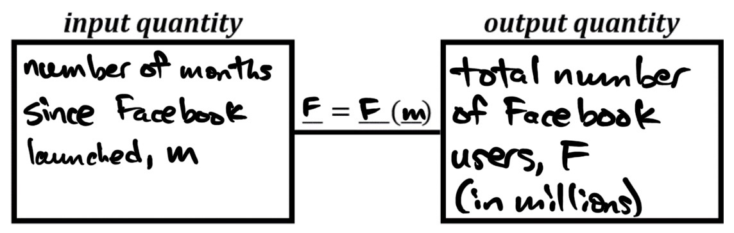
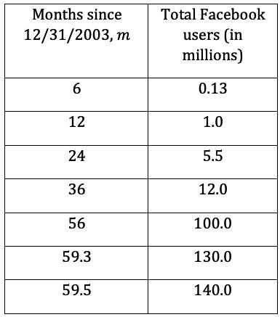
Changes in quantities and rates of change
THE BIG 5: When working with a function, always …
(1) … identify each of the quantities involved, and
(2) … identify the units being used to measure these quantities.
(3) … define a variable to represent each quantity,
(4) … classify each as an input or output quantity, and
(5) … express the relationship in function notation.
EXAMPLE: Total number of Facebook users as
a function of the number of months since FB launched
Notes:
JPC

Slide 13
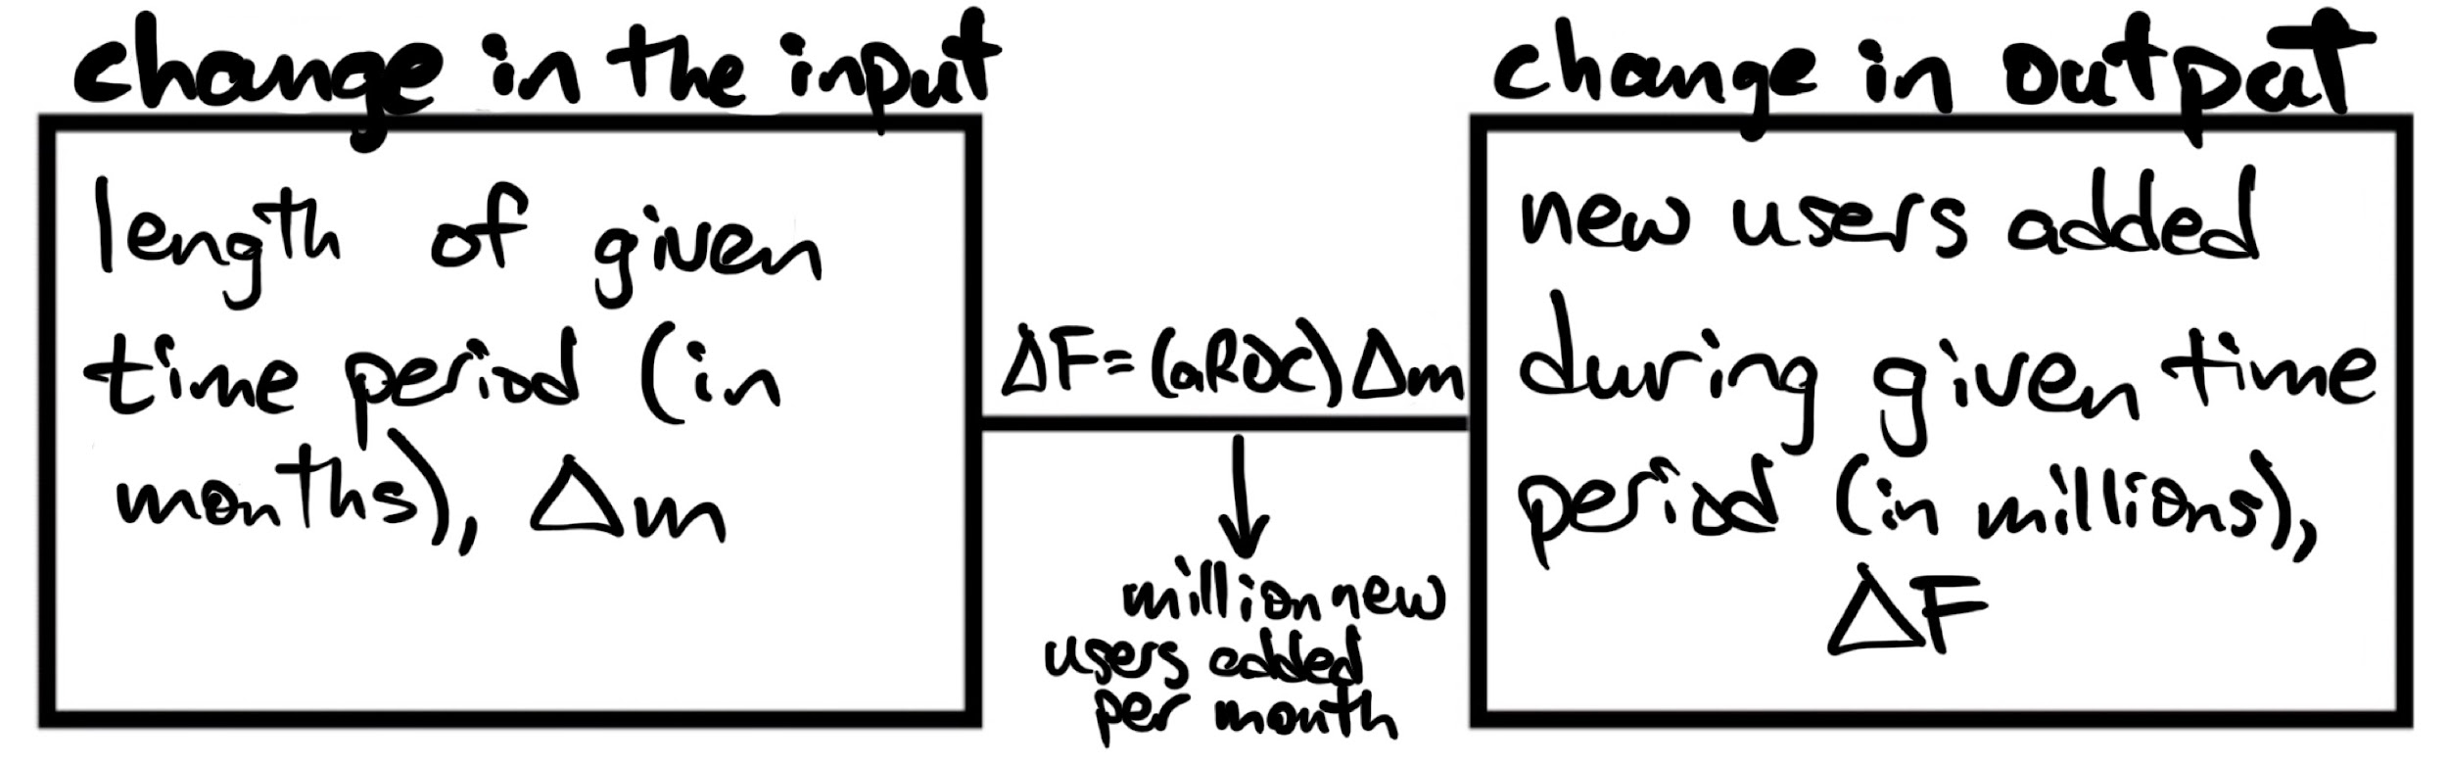
Changes in quantities and rates of change
(1) … identify each of the quantities involved, and
(2) … identify the units being used to measure these quantities.
(3) … define a variable to represent each quantity,
(4) … classify each as an input or output quantity, and
(5) … express the relationship in function notation.
EXAMPLE: Total number of Facebook users as
a function of the number of months since FB launched
Notes:
JPC

Slide 14
Summary: Functions and Modeling …
is an alternative to college algebra that uses technological tools (largely as a replacement for symbolic manipulation) to investigate real-world scenarios
aims to support students in developing productive and flexible understandings of functions and function concepts, for example:
Fluency with various function representations (table, graph, words, formula) for function types (linear, exponential, etc) and related concepts (i.e. aROC, concavity, etc)
Quantities, changes in quantities, rates of change (average rate of change, constant rate of change) and their meanings in various real-world contexts
Notes:
JPC

