Slide 1

A Discussion About Conceptual Analysis

Slide 2
What is a conceptual analysis?

Slide 3

Conceptual Analysis
Phases of instructional design:
What does it mean to understand a particular mathematical idea?
What is the nature of the conceptual activity involved in constructing the targeted understanding?
What instructional resources might engender this conceptual activity?
Phase 1
Phase 2
Phase 3

Slide 4
Conceptual Analysis
Conceptual analysis involves:
  Describing the ways of knowing an idea that are most advantageous for students’ subsequent learning;
  Clarifying the mental actions that will enable the learner to construct the intended understanding;
  Designing instructional resources to engender such mental activity.

Slide 5
What is a conceptual analysis?
An articulation of “what students might understand when they know a particular idea in various ways” (Thompson, 2008, p. 43).
Conceptual analysis …
  Is an explicit description of what “conceptual understanding” actually means in relation to a given topic.
  There is great value in making these kinds of descriptions explicit (rather than leaving them implicit and unstated)
Notes:
“Conceptual analysis basically means trying to understand exactly how a learner conceives of a mathematical idea - what is the theory in their head about what's really going on?”

Slide 6
Why is it important to conduct a conceptual analysis?

Slide 7
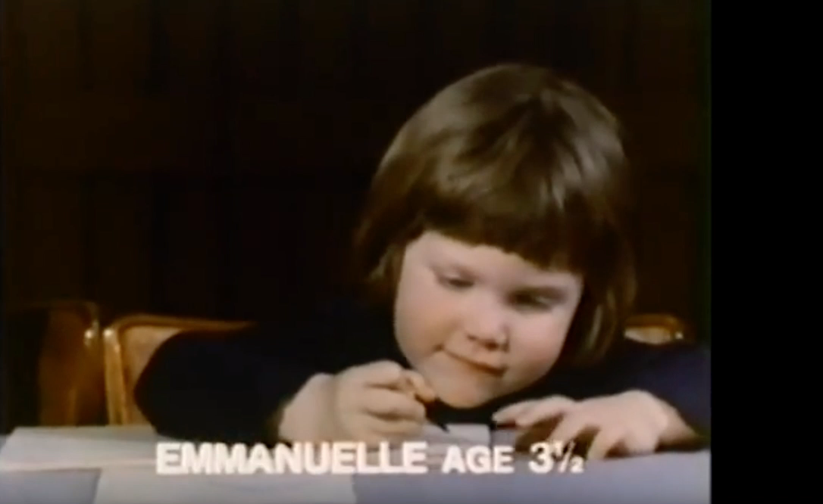
What’s going on here?

Slide 8


Regular
Polygon
Symmetric Group S3
Equiangular

Slide 9
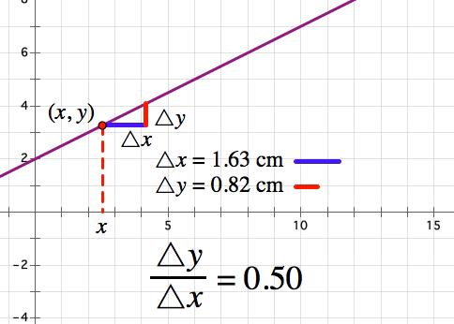

Linear functions are lines
y - y1 = m(x - x1)

Slide 10
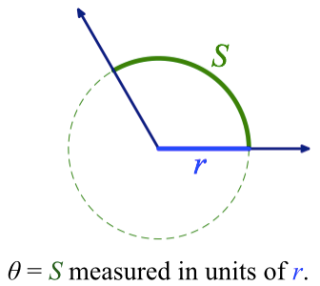
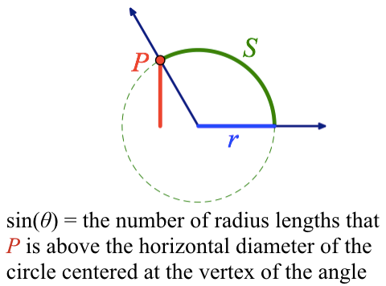
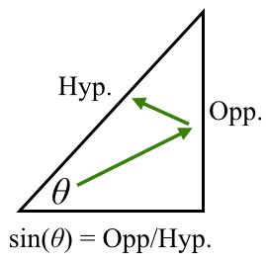
sin(θ)

Slide 11
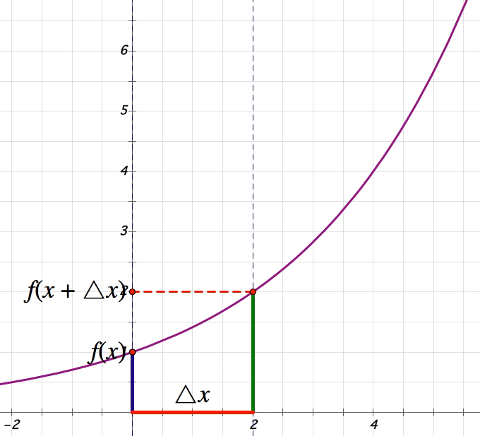
The graph goes
up really fast
f is an exponential
function

Slide 12
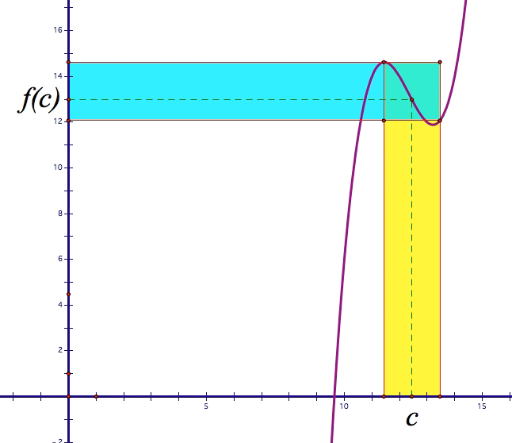
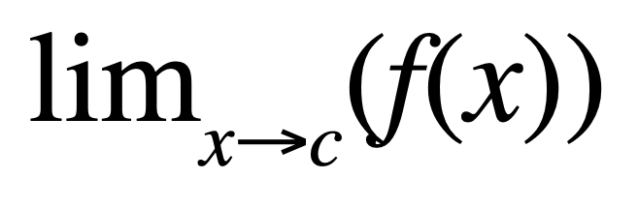
x becomes c

Slide 13
Goal of mathematics instruction
The goal of mathematics instruction is to engage students in the specific activity that might enable them to interpret and operate on mathematical stimuli (e.g., symbols/equations/representations) in the ways we intend.

Slide 14
Goal of mathematics instruction
The goal of mathematics instruction is to engage students in the specific activity that might enable them to interpret and operate on mathematical stimuli (e.g., symbols/equations/representations) in the ways we intend.

Slide 15
Provide an example of instructional resources based on a conceptual analysis

Slide 16
An Example
A curricular objective might be stated as: “students will be able to identify when two algebraic expressions are equivalent.”
A conceptual analysis is an answer to:
  how might a student need to understand equivalence in order to do so productively?
  (what does it mean to have a “conceptual understanding” of the equivalence of algebraic expressions?”)

Slide 17
An Example
A conceptual analysis is an answer to: how might a student need to understand equivalence in order to do so?
A “conceptual understanding” of equivalent expressions involves (at least) 3 complementary conceptions: expressions as equivalent when …
  Numerical: they have the same numerical value for all “reasonable” inputs
  Transformational: one can be manipulated into the other using algebraic properties
  Descriptive: they represent the same magnitude of a given quantity

Slide 18
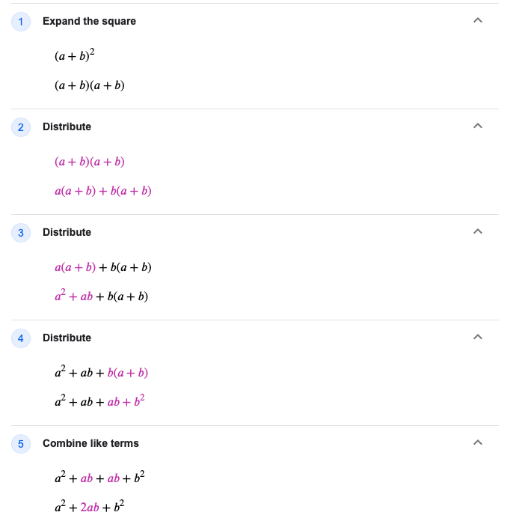
Numerical?
Transformational?
Descriptive?
A conceptual analysis is an answer to:
How might a student need to conceptualize equivalence to successfully perform these operations?

Slide 19
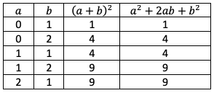
An Example
A conceptual analysis is an answer to:
How might a student need to conceptualize equivalence to successfully perform these operations?
Numerical?
Transformational?
Descriptive?

Slide 20
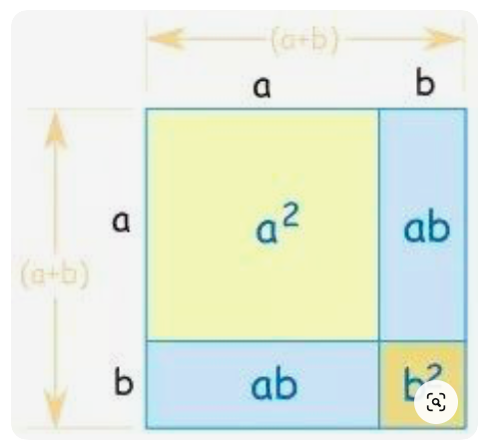
An Example
A conceptual analysis is an answer to:
How might a student need to conceptualize equivalence to successfully perform these operations?
Numerical? Transformational? Descriptive?
Why might it be useful to outline these three understandings?

Slide 21
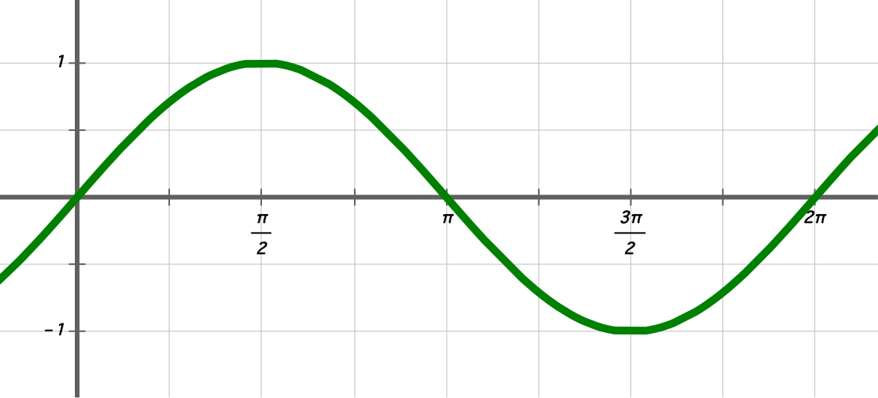
Example: The sine function
Hyp.
Opp.
θ
sin(θ) = Opp/Hyp.

Slide 22
Example: The sine function
What are the abstractions that I hypothesize a student needs to make in order to construct this understanding of the output of the sine/cosine function?
What does it mean to understand the output of the sine/cosine function?
What experiences might provoke such abstractions?
Phase I
Phase III
Phase II
What do I want my students to “see” when they look at the symbols “sin(θ)”?

Slide 23
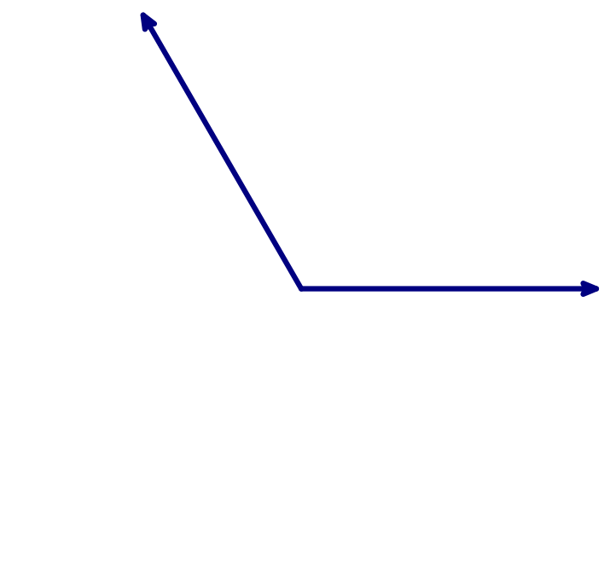
Angle measure as a quantification of a class of subtended arcs

Slide 24
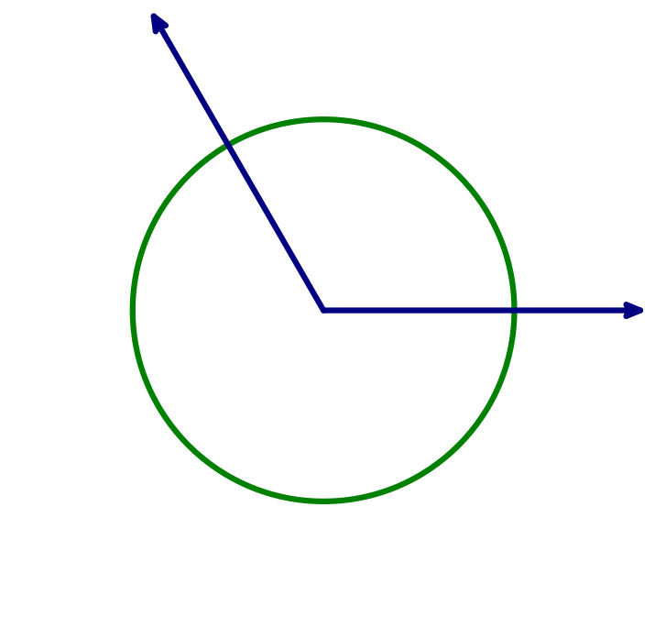
Angle measure as a quantification of a class of subtended arcs

Slide 25
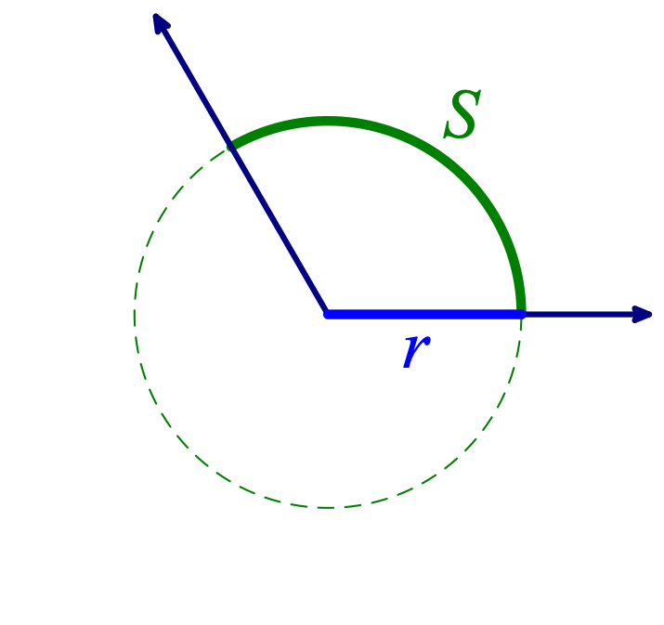
Angle measure as a quantification of a class of subtended arcs
θ = S measured in units of r.

Slide 26
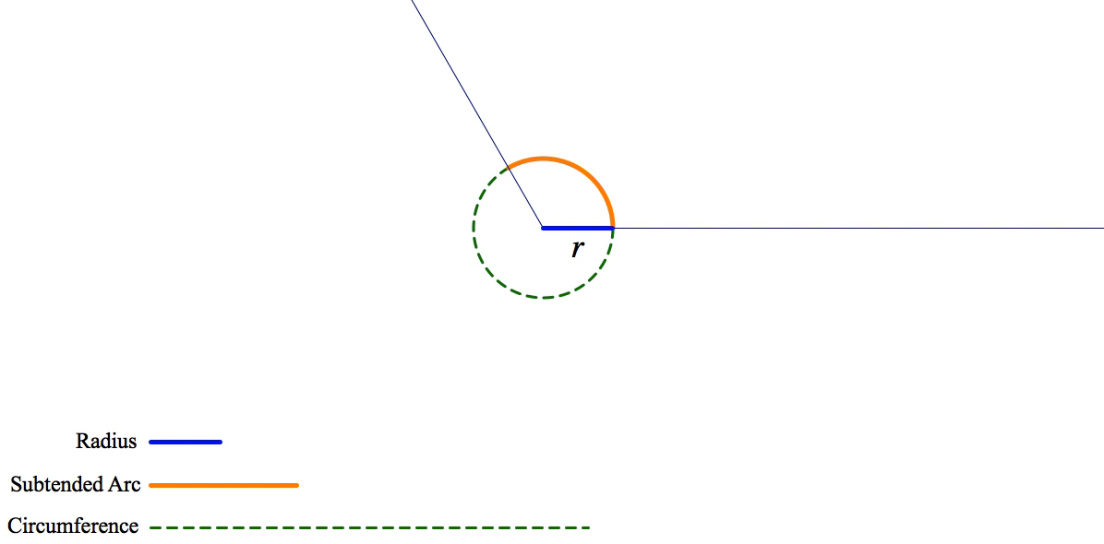
Angle measure as a quantification of a class of subtended arcs

Slide 27
Output of the sine function

Slide 28
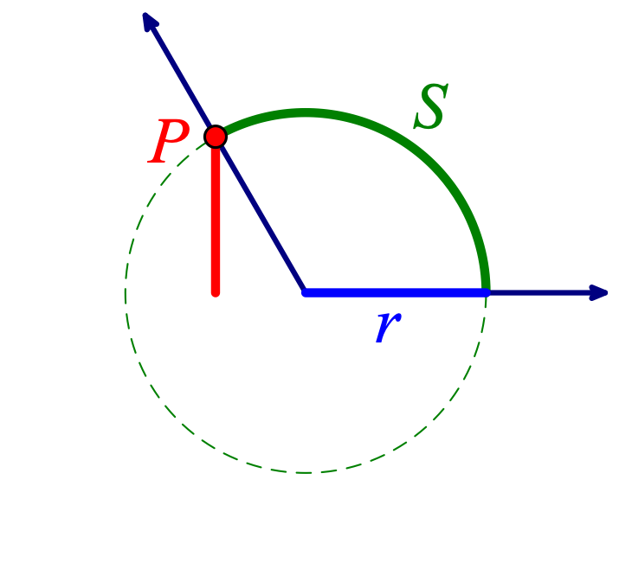
Output of the sine function
sin(θ) = the number of radius lengths that P is above the horizontal diameter of the circle centered at the vertex of the angle.

Slide 29
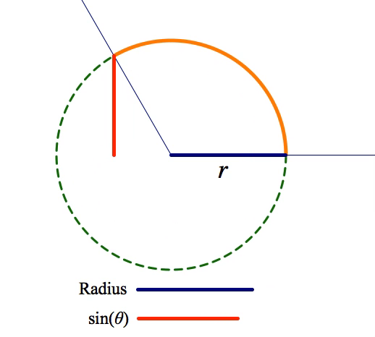
Output of the sine function

Slide 30
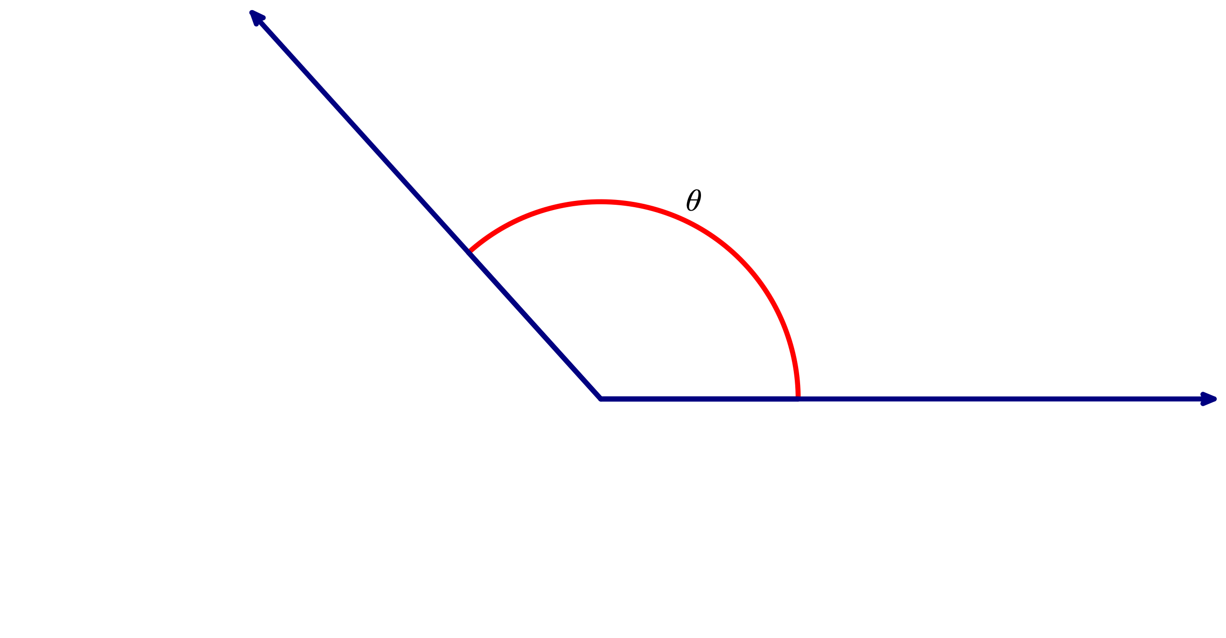
Output of the sine function

Slide 31
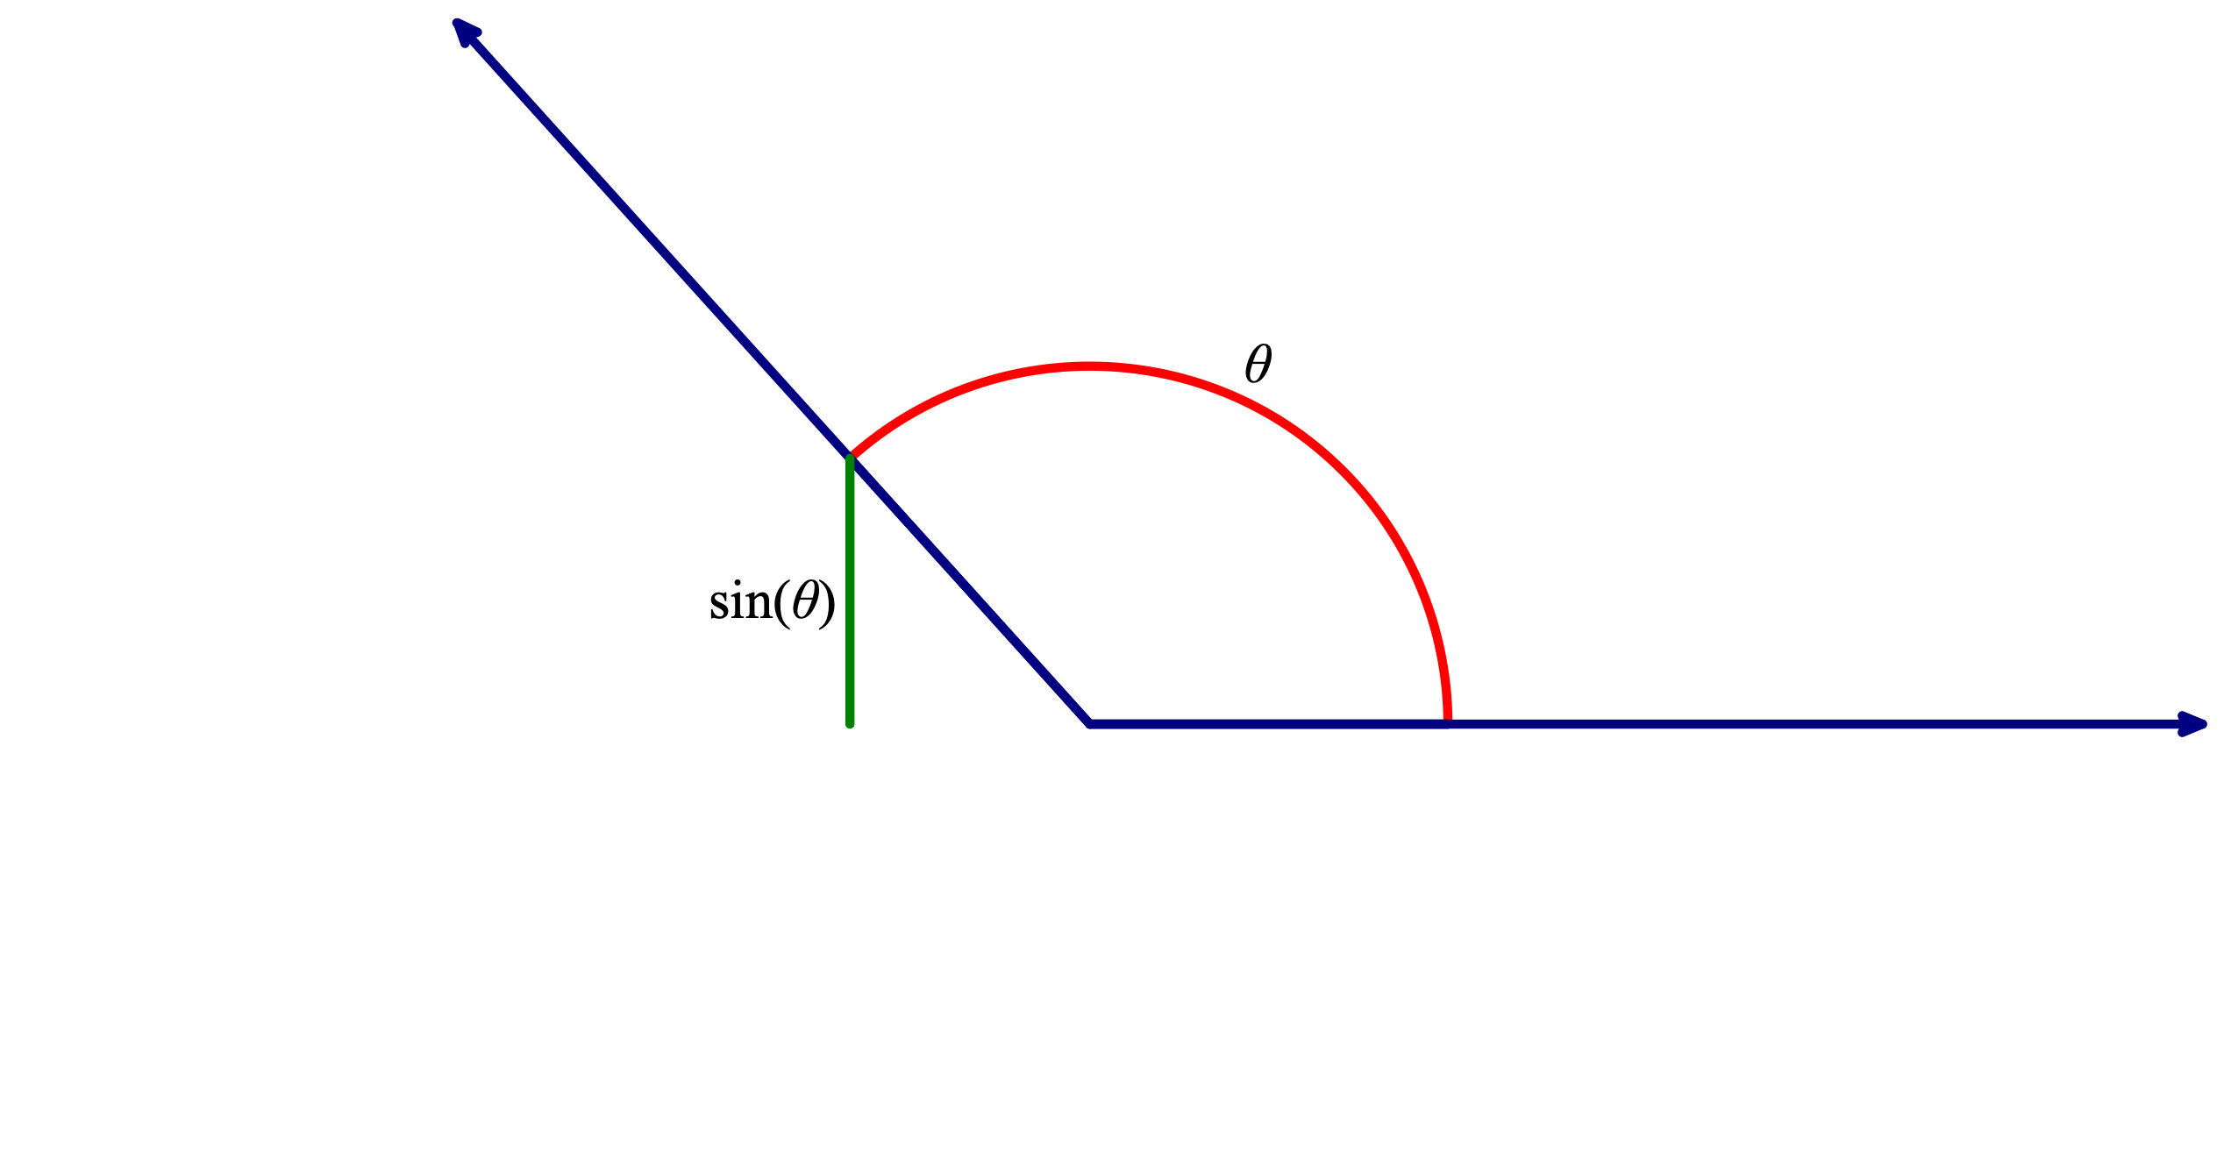
Output of the sine function

Slide 32
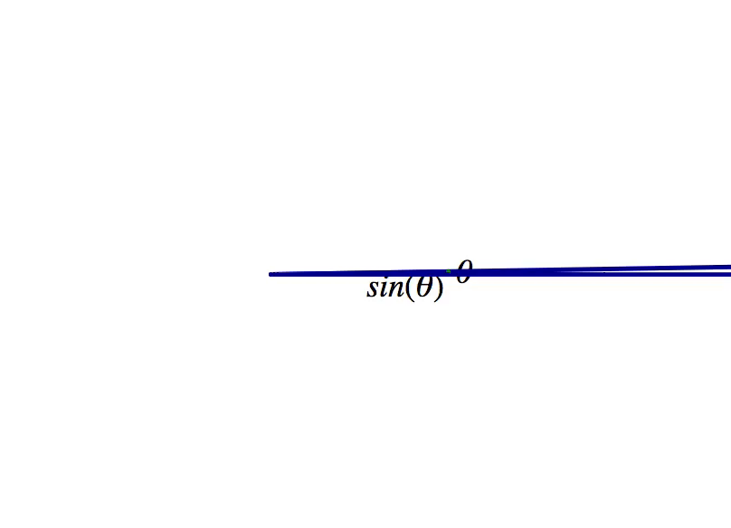
Output of the sine function

Slide 33
Example: The sine function
What are the abstractions that I hypothesize a student needs to make in order to construct this understanding of the output of the sine/cosine function?
What does it mean to understand the output of the sine/cosine function?
What experiences might provoke such abstractions?
Phase I
Phase III
Phase II

Slide 34
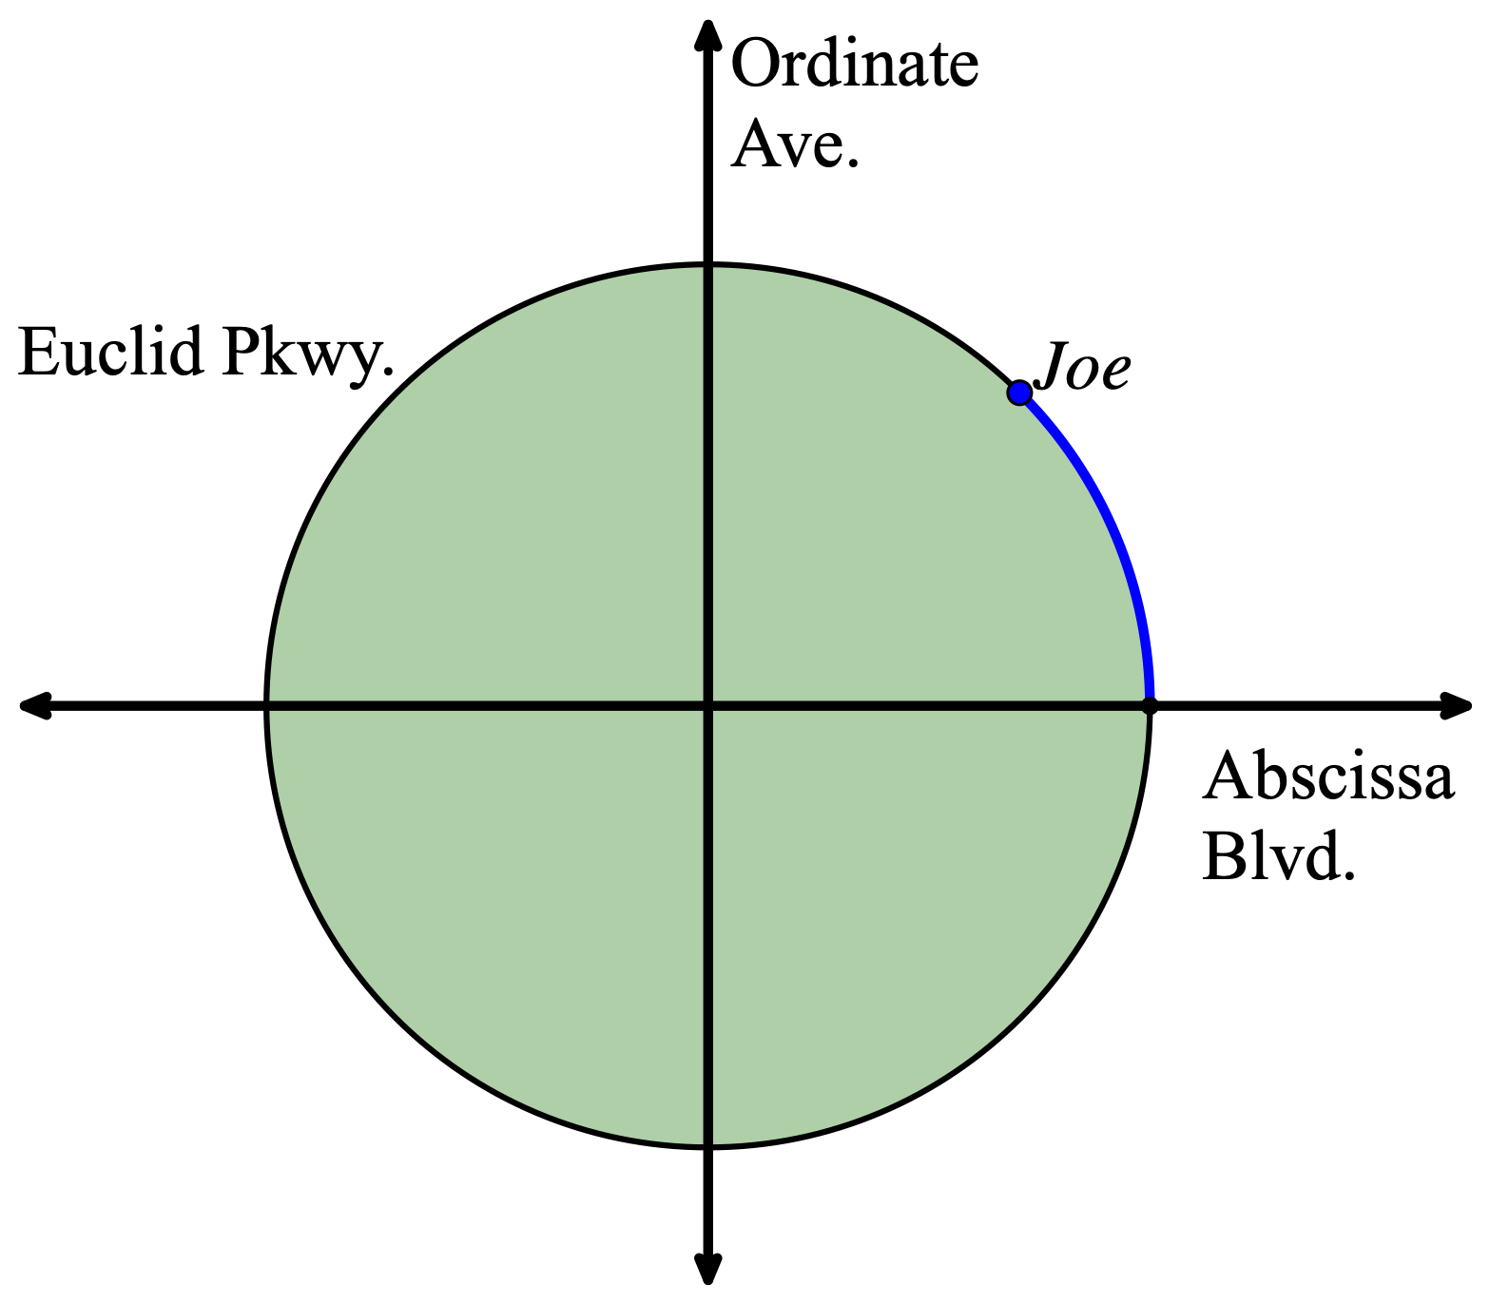
Context of the instructional sequence
Suppose Joe is riding his bike on Euclid Parkway, a perfectly circular road that defines the city limits of Flatville. Ordinate Avenue is a road running vertically (north and south) through the center of Flatville and Abscissa Boulevard is a road running horizontally (east and west) through the center of Flatville. Assume Joe begins riding his bike at the east intersection of Euclid Parkway and Abscissa Boulevard in the counterclockwise direction.

Slide 35
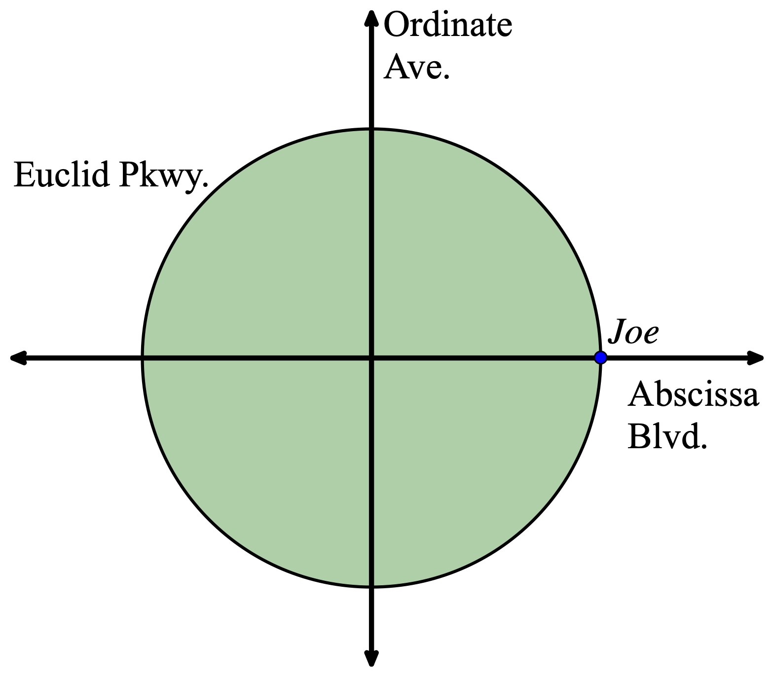
Task 1: If Joe’s path has swept out an angle of one radian, approximately how many radius lengths is Joe north of Abscissa Boulevard?

Slide 36

Task 1: If Joe’s path has swept out an angle of one radian, approximately how many radius lengths is Joe north of Abscissa Boulevard?
≈ 0.85 of
radius
1 radius length

Slide 37
Task 2: If Joe’s path has swept out an angle of two radians, approximately how many radius lengths is Joe east of Ordinate Avenue?

Slide 38

Task 2: If Joe’s path has swept out an angle of two radians, approximately how many radius lengths is Joe east of Ordinate Avenue?
2 radius lengths
≈ -0.4 of
radius

Slide 39
Repeated Reasoning
Task 3: If Joe has ridden four times the distance of the radius of Flatville, how many radius lengths is Joe north of Abscissa Boulevard.
Task 4: If Joe’s path has swept out an angle of 3.5 radians, how many radius lengths is Joe east of Ordinate Avenue?

Slide 40
Task 5: If Joe’s path has swept out an angle of θ radians, explain how you would use this applet to estimate Joe’s distance north of Abscissa Boulevard and east of Ordinate Avenue in radius lengths?

Slide 41

Task 5(a): If Joe’s path has swept out an angle of θ radians, explain how you would use this applet to estimate Joe’s distance north of Abscissa Boulevard?
Move Joe so that he has ridden θ radius lengths.
Attend to Joe’s distance north of Abscissa Blvd.
Multiplicatively compare this distance to the radius of Flatville.
θ radius lengths

Slide 42
Task 5(b): If Joe’s path has swept out an angle of θ radians, explain how you would use this applet to estimate Joe’s distance east of Ordinate Avenue?
Move Joe so that he has ridden θ radius lengths.
Attend to Joe’s distance east of Ordinate Ave.
Multiplicatively compare this distance to the radius of Flatville.
θ radius lengths

Slide 43
Introduce sin(θ) and cos(θ) notation:
Task 6: If we know the angle swept out by Joe’s path (in radians), there are two buttons on our calculator that tell us how many radius lengths Joe is north of Abscissa Boulevard and east of Ordinate Avenue respectively. What are they?

Slide 44
Task 7: Place Joe in a position on Euclid Parkway to estimate the following:
        sin(0.5)
        cos(3/4)
        sin(2)
        cos(4)

Slide 45
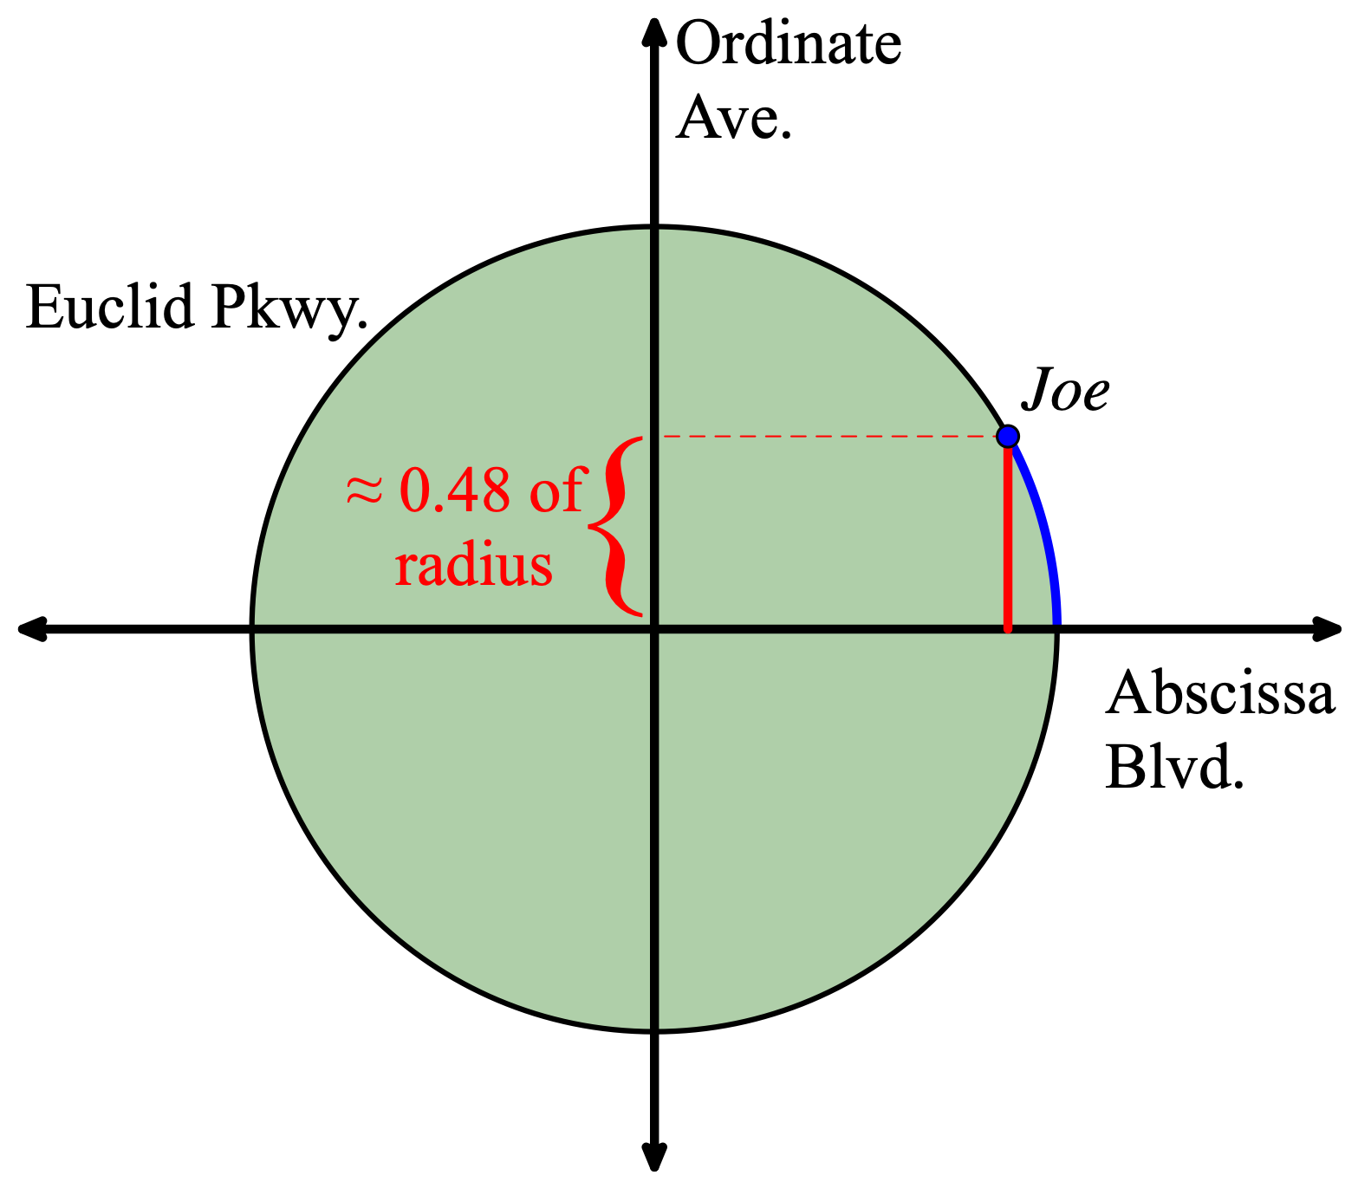
Task 7: Place Joe in a position on Euclid Parkway to estimate the following:
        sin(0.5)
        cos(3/4)
        sin(2)
        cos(4)

Slide 46
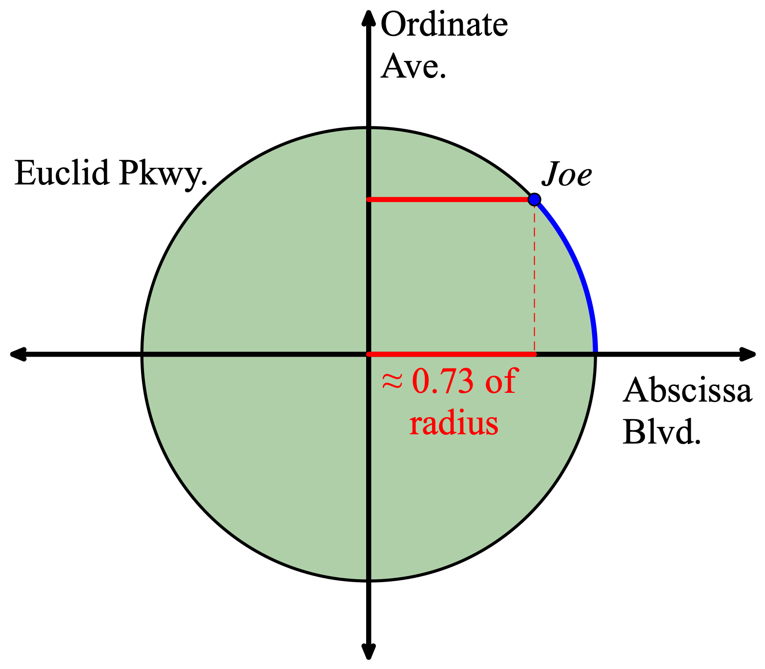
Task 7: Place Joe in a position on Euclid Parkway to estimate the following:
        sin(0.5)
        cos(3/4)
        sin(2)
        cos(4)

Slide 47
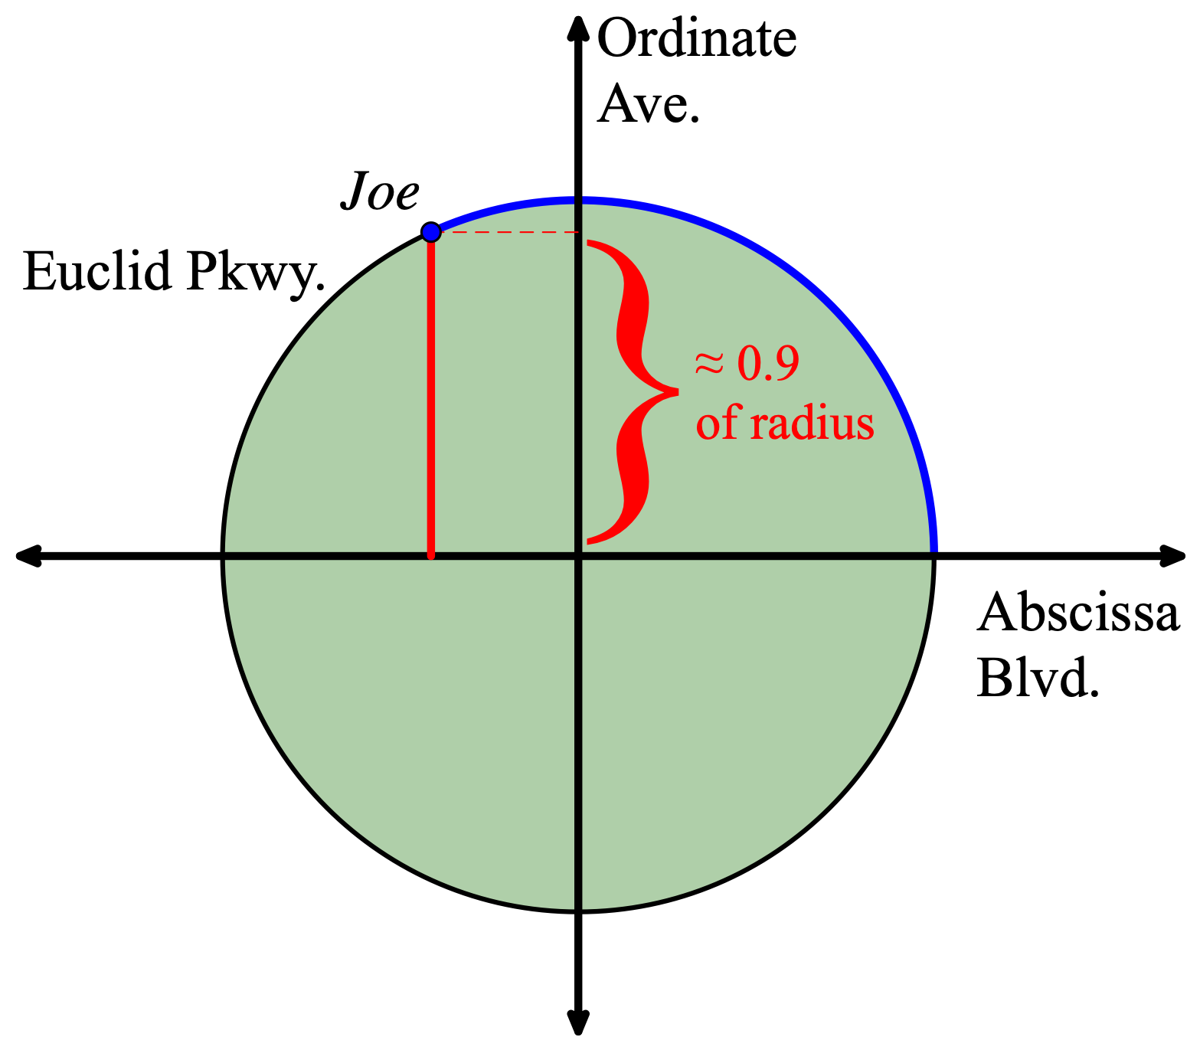
Task 7: Place Joe in a position on Euclid Parkway to estimate the following:
        sin(0.5)
        cos(3/4)
        sin(2)
        cos(4)

Slide 48
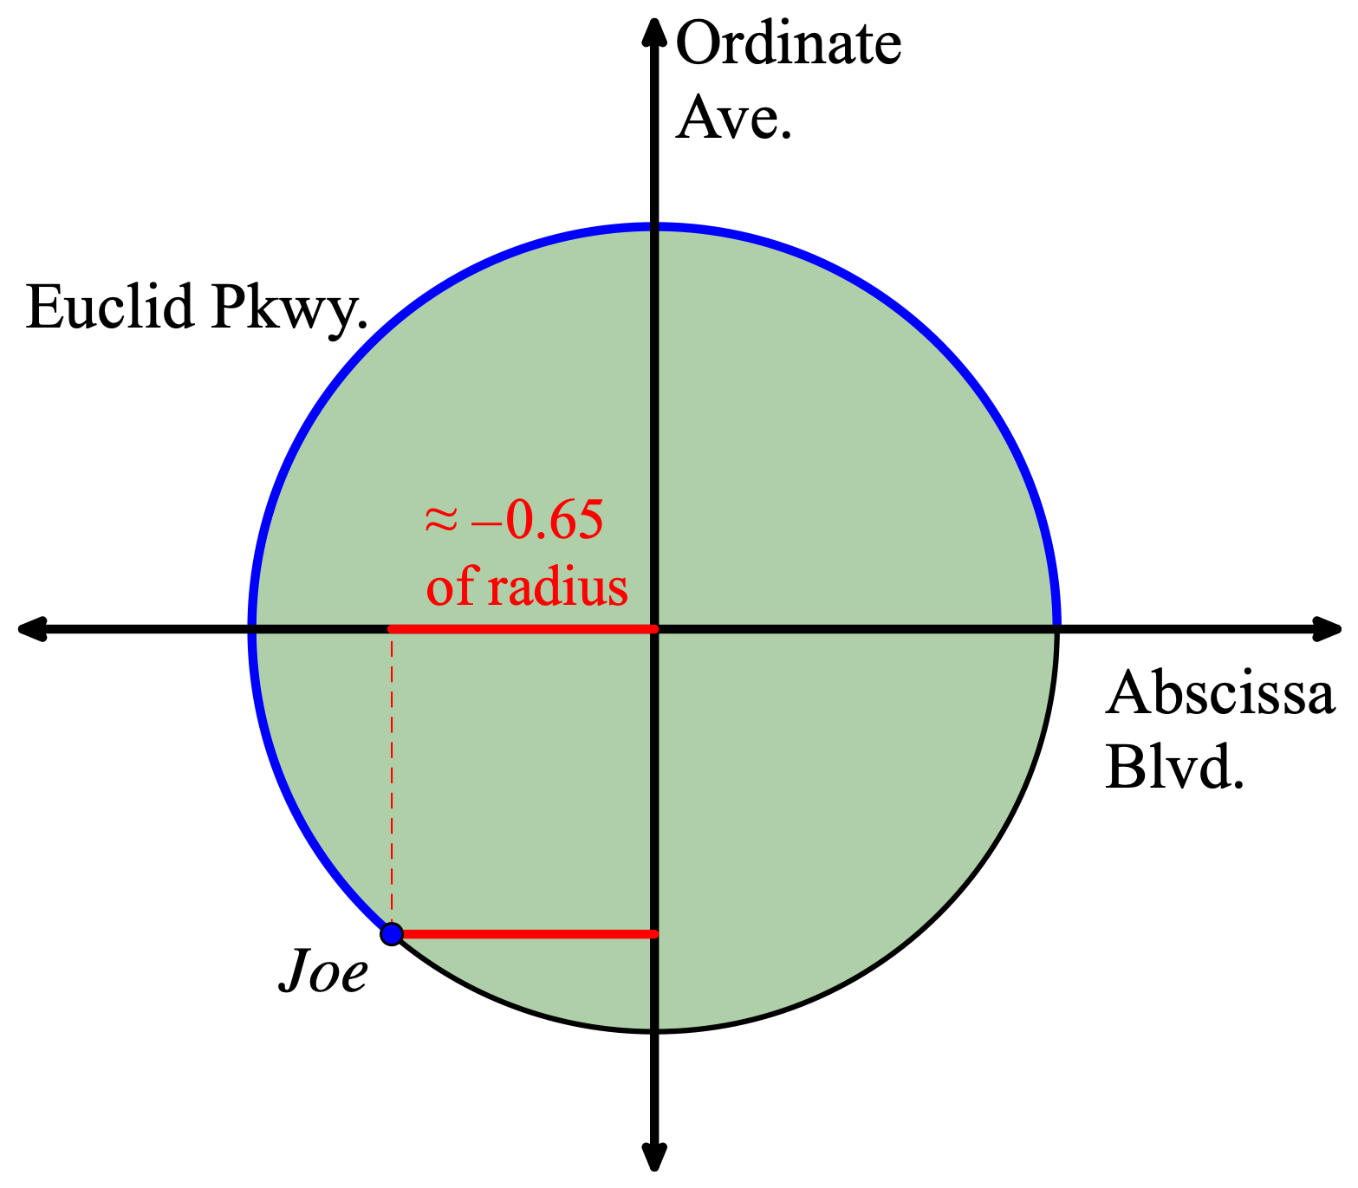
Task 7: Place Joe in a position on Euclid Parkway to estimate the following:
        sin(0.5)
        cos(3/4)
        sin(2)
        cos(4)

Slide 49
Task 8: Place Joe in a position on Euclid Parkway to estimate the solution to the following equations:
sin(x) = 0.6
cos(x) = -0.25

Slide 50
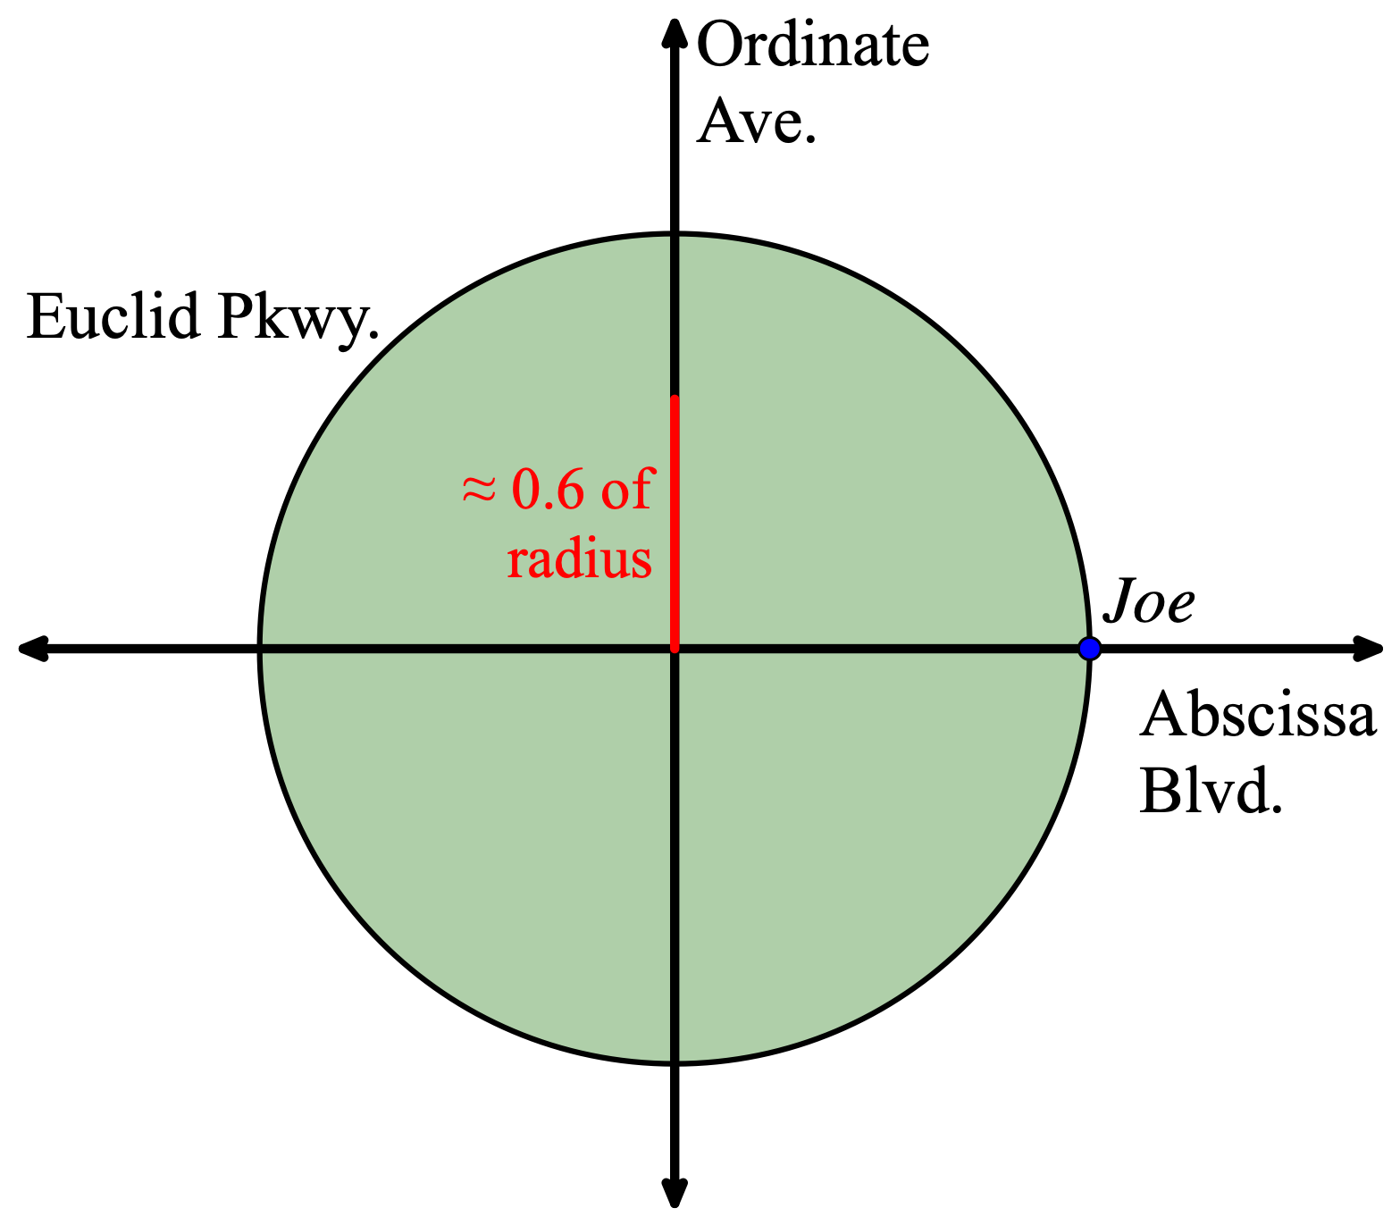
Task 8: Place Joe in a position on Euclid Parkway to estimate the solution to the following equations:
sin(x) = 0.6
cos(x) = -0.25

Slide 51

Task 8: Place Joe in a position on Euclid Parkway to estimate the solution to the following equations:
sin(x) = 0.6
cos(x) = -0.25

Slide 52

Task 8: Place Joe in a position on Euclid Parkway to estimate the solution to the following equations:
sin(x) = 0.6
cos(x) = -0.25

Slide 53
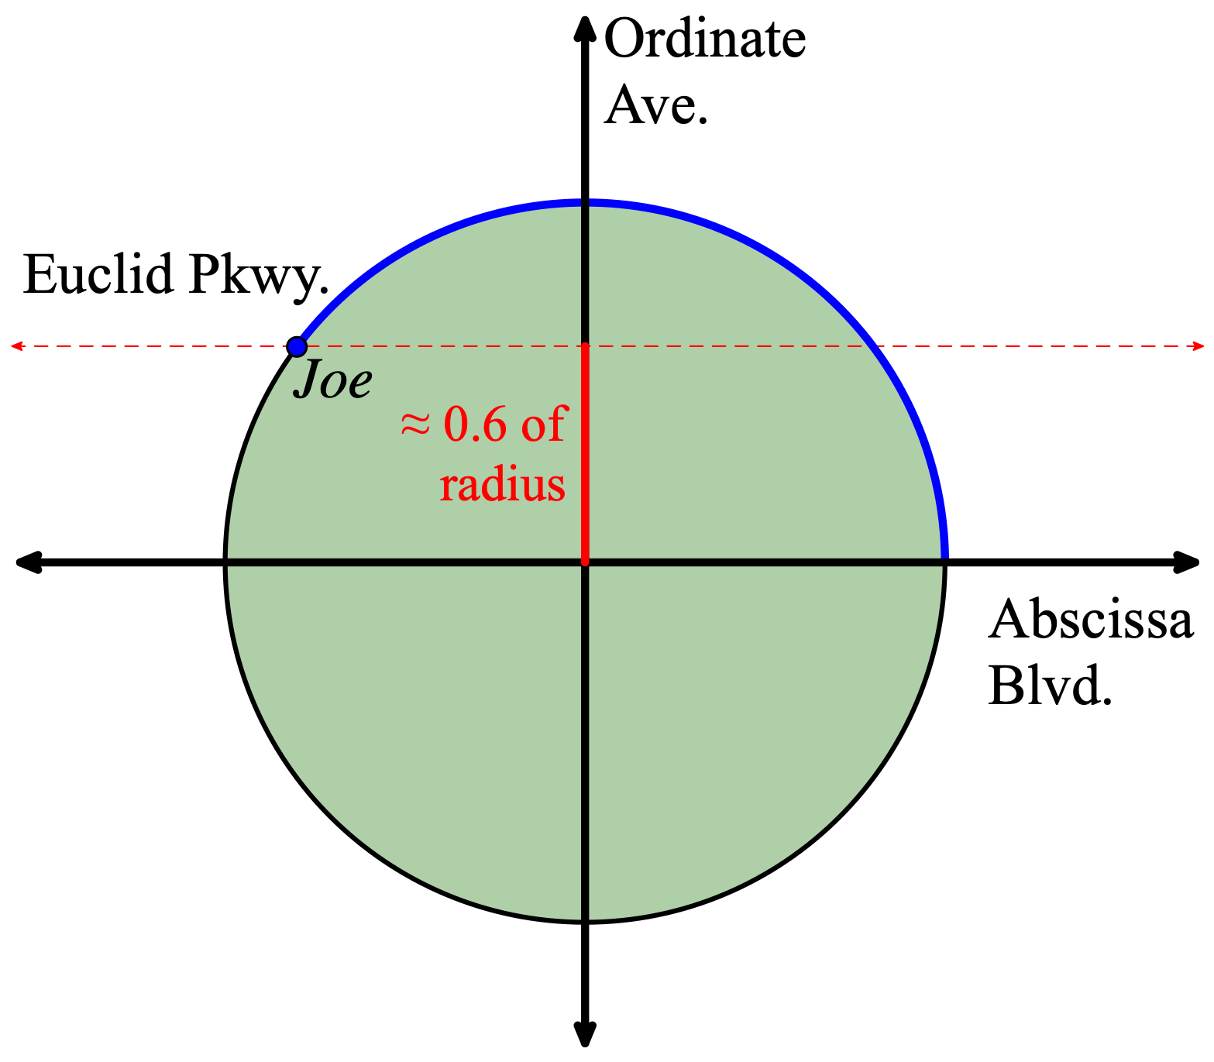
Task 8: Place Joe in a position on Euclid Parkway to estimate the solution to the following equations:
sin(x) = 0.6
cos(x) = -0.25

Slide 54
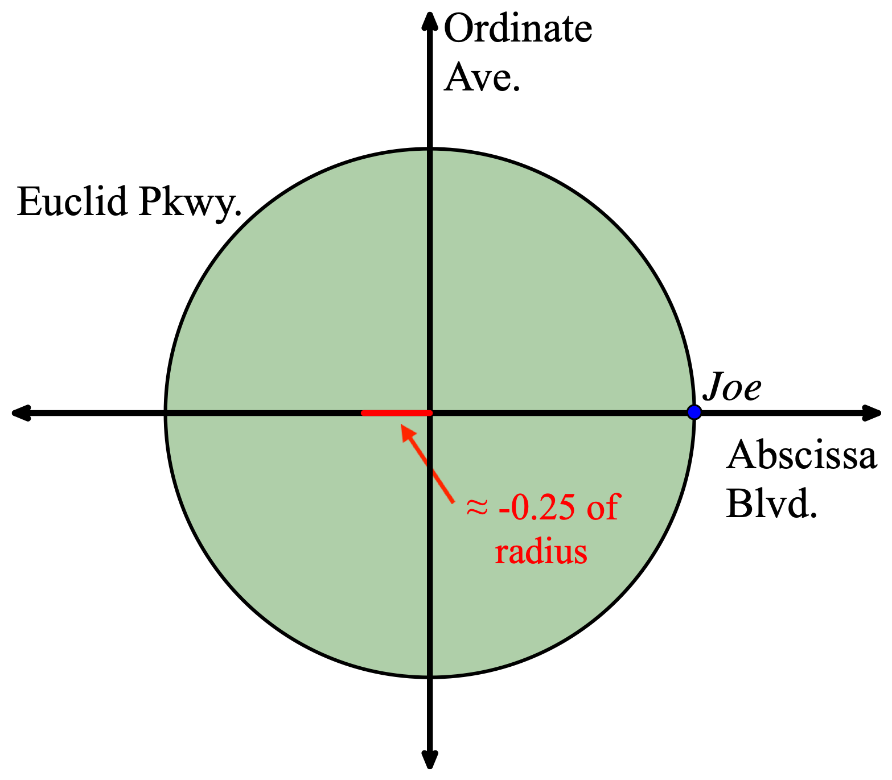
Task 8: Place Joe in a position on Euclid Parkway to estimate the solution to the following equations:
sin(x) = 0.6
cos(x) = -0.25

Slide 55

Task 8: Place Joe in a position on Euclid Parkway to estimate the solution to the following equations:
sin(x) = 0.6
cos(x) = -0.25

Slide 56
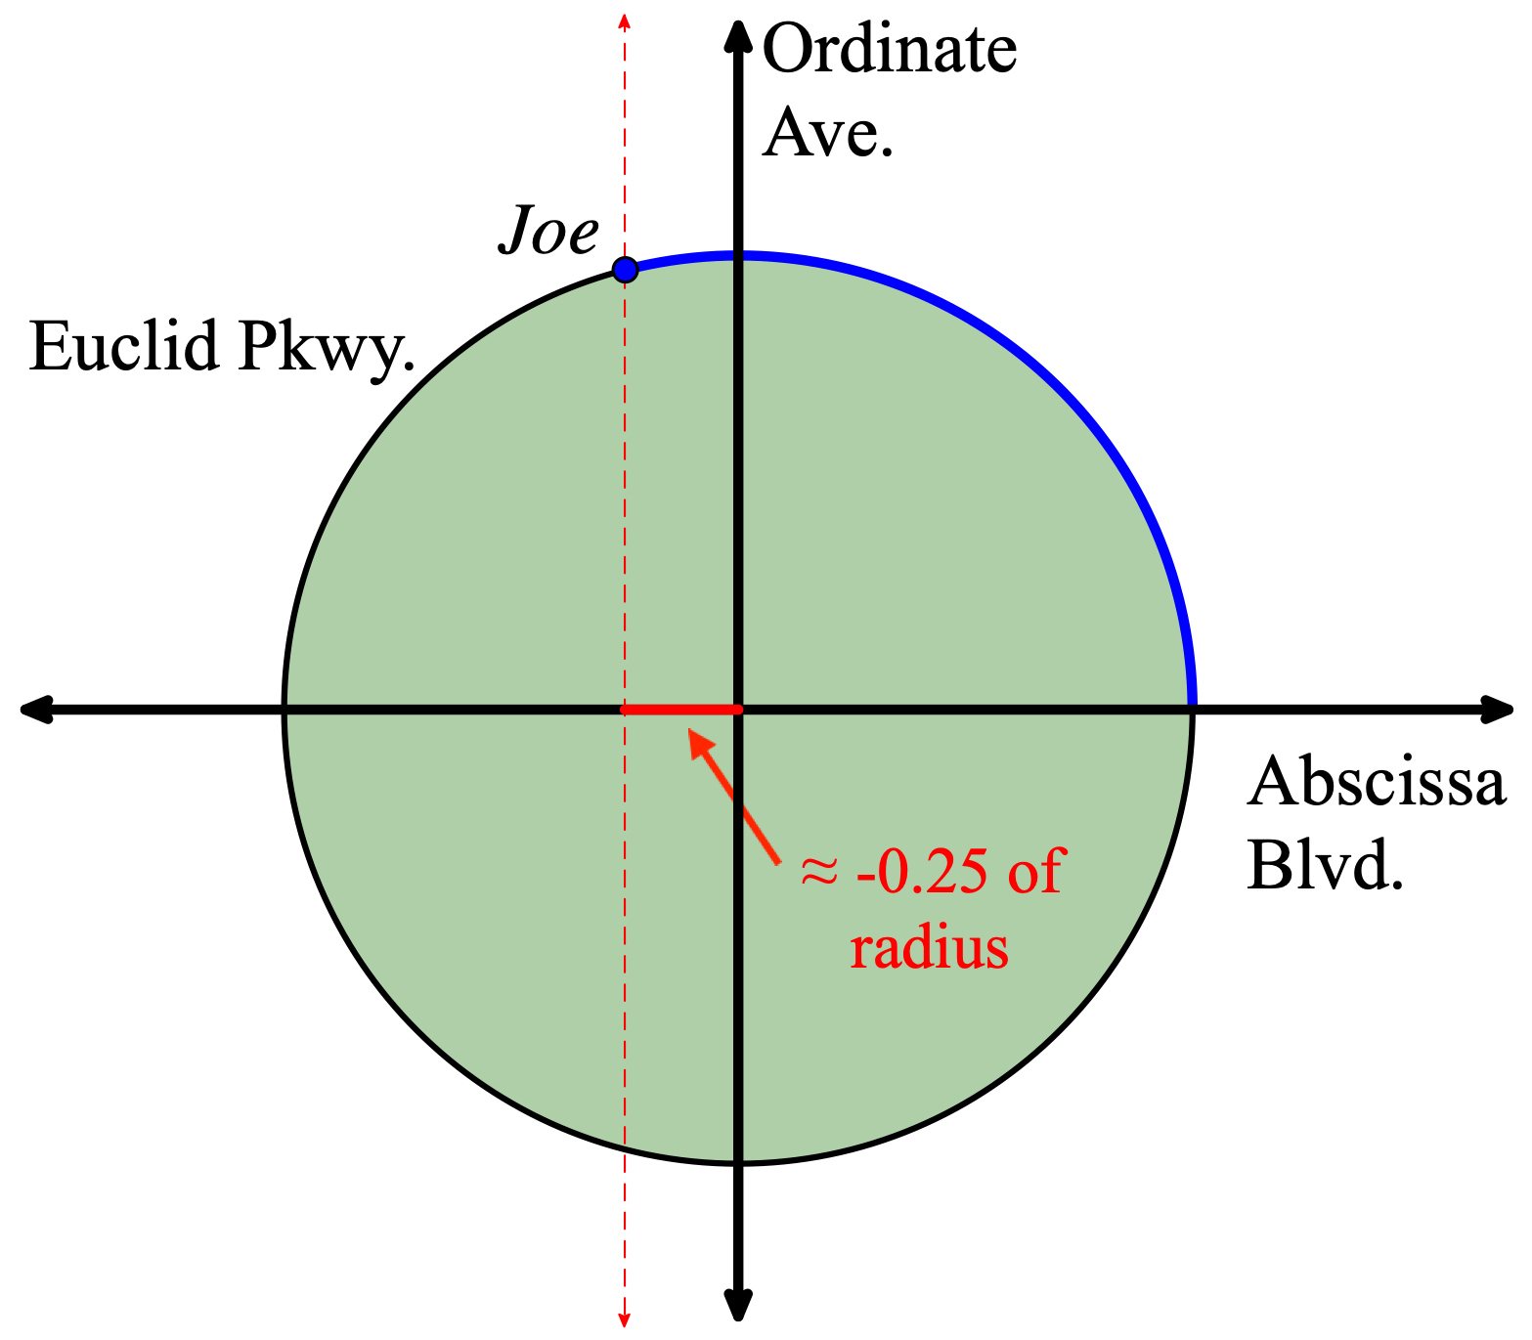
Task 8: Place Joe in a position on Euclid Parkway to estimate the solution to the following equations:
sin(x) = 0.6
cos(x) = -0.25

Slide 57
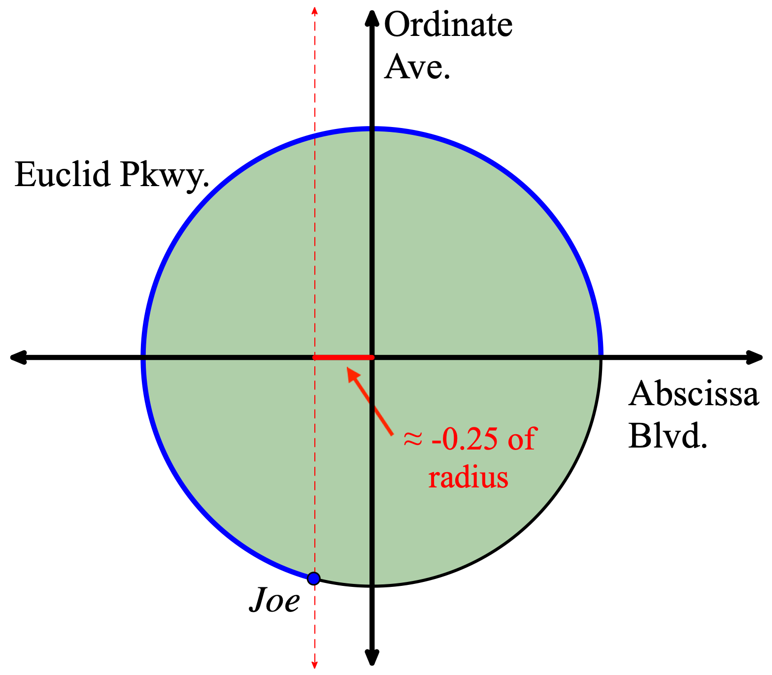
Task 8: Place Joe in a position on Euclid Parkway to estimate the solution to the following equations:
sin(x) = 0.6
cos(x) = -0.25

Slide 58
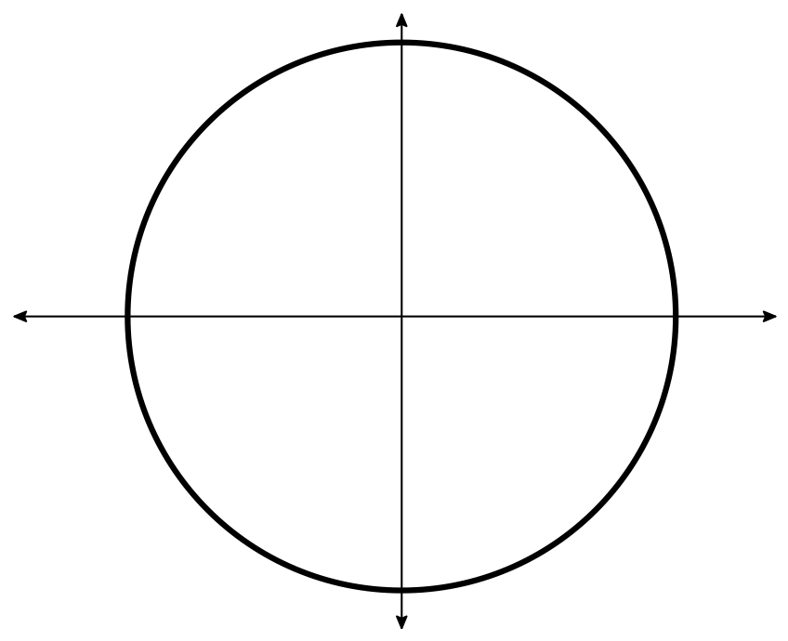
Task 9: Use the circle below to illustrate what the values 2.5 and 0.6 represent in the equality sin(2.5) = 0.6

Slide 59
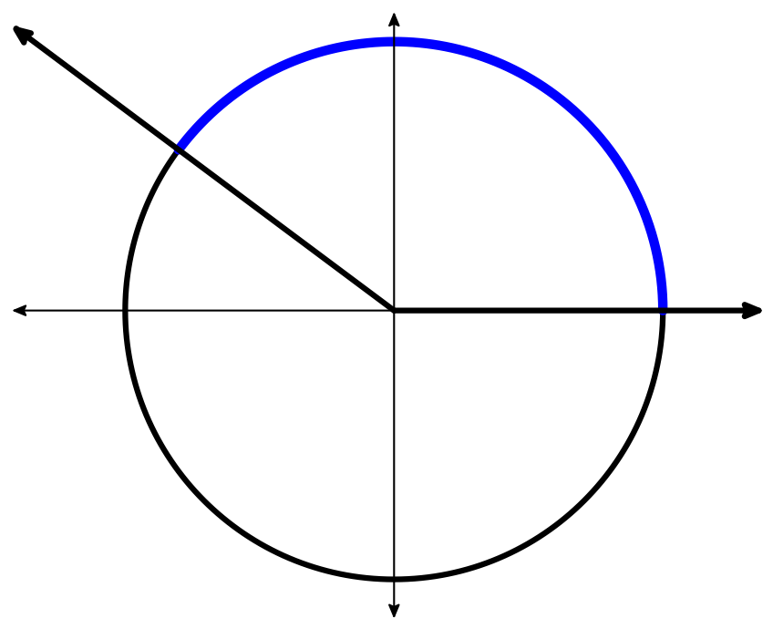
Task 9: Use the circle below to illustrate what the values 2.5 and 0.6 represent in the equality sin(2.5) = 0.6
2.5 radius lengths

Slide 60
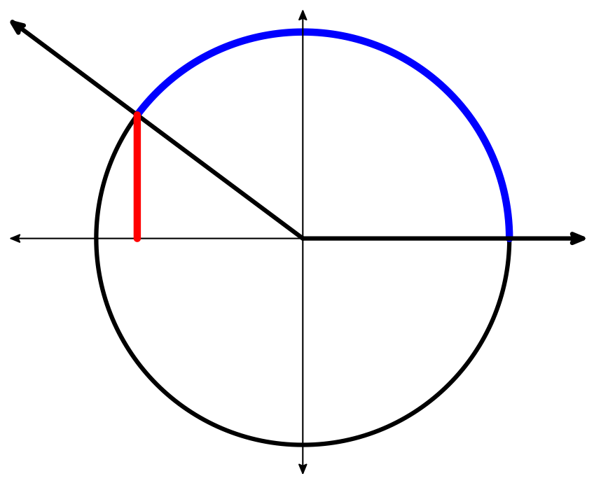
Task 9: Use the circle below to illustrate what the values 2.5 and 0.6 represent in the equality sin(2.5) = 0.6
2.5 radius lengths
0.6 radius
length

Slide 61
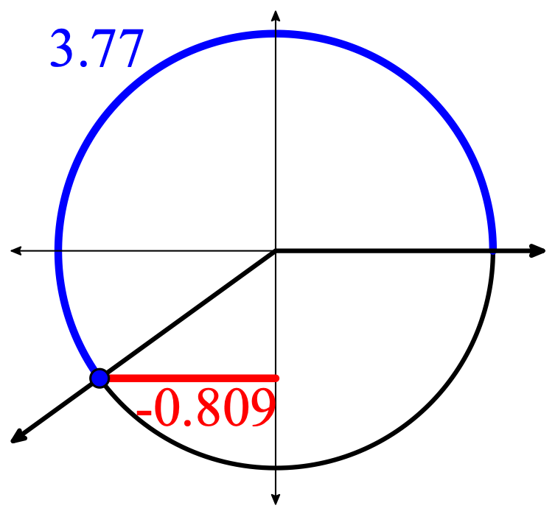
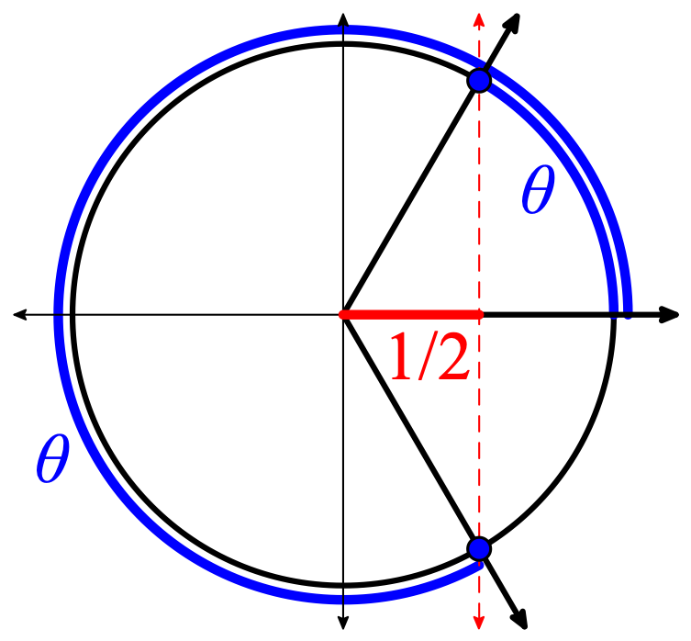
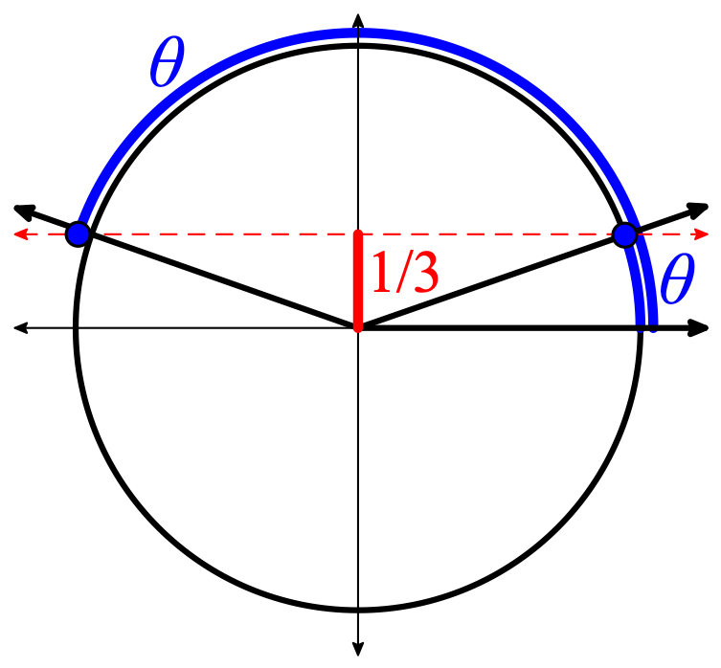
Task 10: Use the circle below to illustrate what the values 3.77 and -0.809 represent in the equality cos(3.77) = -0.809.
Task 11: Use the circle below to draw the terminal ray of the angle with a measure of θ radians that satisfies the property cos(θ) = 1/2.
Task 12: Use the circle below to draw the terminal ray of the angle with a measure of θ radians that satisfies the property sin(θ) = 1/3.

Slide 62
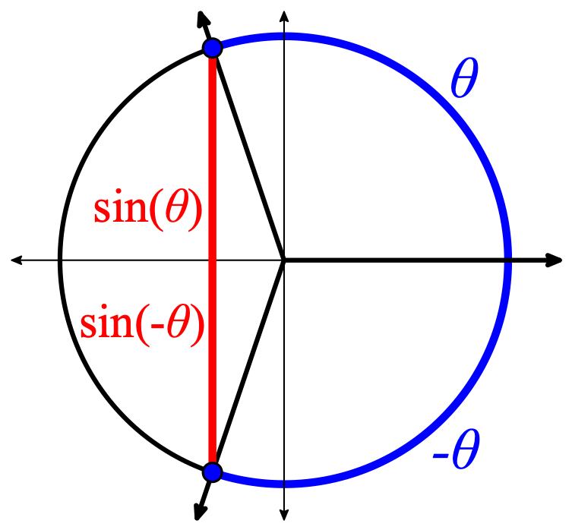
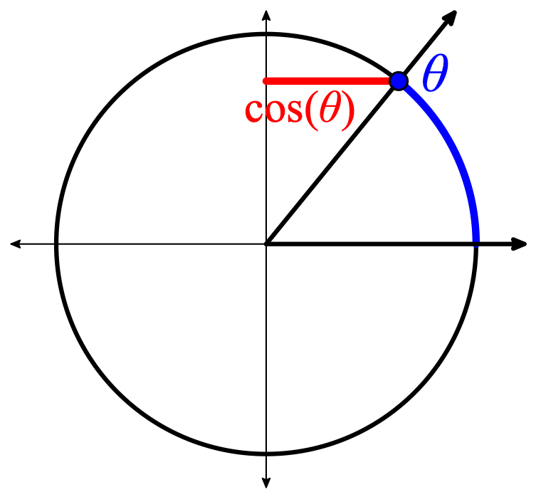
Task 13: Use the circle below to illustrate the equality sin(θ) = θ/2.
Task 14: Use the circle below to illustrate the equality cos(θ) = 0.7(θ).

Slide 63
How does conceptual analysis relate to the MIP components of inquiry?

Slide 64
MIP Components of Mathematical Inquiry
Active Engagement
Meaningful Applications
Academic Success Skills

Slide 65
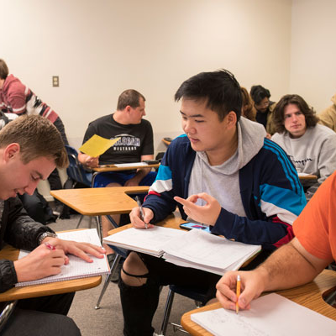
Active Learning
Students engage in active learning when they work to resolve a problematic situation whose resolution requires them to select, perform, and evaluate actions whose structures are equivalent to the structures of the concepts to be learned.

Slide 66
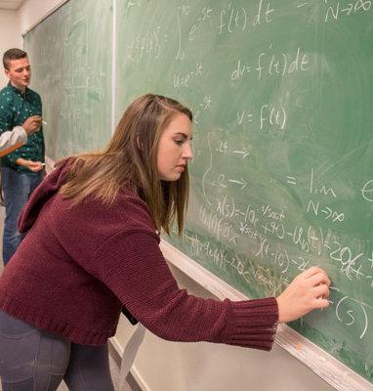
Meaningful Applications
Applications are meaningfully incorporated in a mathematics class to the extent that they support students in identifying mathematical relationships, making and justifying claims, and generalizing across contexts to extract common mathematical structure.

Slide 67
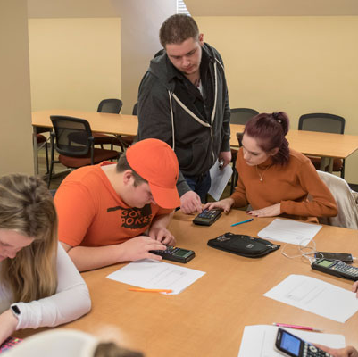
Academic Success Skills
Academic success skills foster students’ construction of their identities as learners in ways that enable productive engagement in their education and the associated academic community.

