Slide 1

Learning Mathematics through Inquiry
Mechanisms
Mechanisms
Mechanisms
Instructional Design
  Active Learning
  Meaningful Applications
  Academic Success Skills
Notes:
We can think of the MIP definitions of Active Learning, Meaningful Applications, and Academic Success Skills as pillars necessary to support successful student learning through inquiry.
To do this effectively, we must understand
1. What benefits (or support) each of these pillars provides
2. How they provide such benefits (the mechanisms through which they operate in the learning process)
Then we can design instructional activities that effectively incorporate these features.

Slide 2

Active learning
Students engage in active learning when they work to resolve a problematic situation whose resolution requires them to select, perform, and evaluate actions whose structures are equivalent to the structures of the concepts to be learned.
Notes:
These slides emphasize multiple important features of the MIP definition of Active Learning.

Slide 3
Active learning
Students engage in active learning when they work to resolve a problematic situation whose resolution requires them to select, perform, and evaluate actions whose structures are equivalent to the structures of the concepts to be learned.
Notes:
Students are not fully engaged by either a lecture in which someone else is doing the primary reasoning (they are not problem-solving).
Students are also not engaged when repeating routine problems that they already know how to work (again they are not problem-solving).
Active learning requires students be perturbed by something truly problematic to them, within their reach, but requiring effort and struggle.

Slide 4
Active learning
Students engage in active learning when they work to resolve a problematic situation whose resolution requires them to select, perform, and evaluate actions whose structures are equivalent to the structures of the concepts to be
learned.
Notes:
Students must be able to participate in deciding how to approach a problem, working the problem, and determining how effective their work was.

Slide 5
Active learning
Students engage in active learning when they work to resolve a problematic situation whose resolution requires them to select, perform, and evaluate actions whose structures are equivalent to the structures of the concepts to be learned.
Notes:
These slides emphasize multiple important features of the MIP definition of Active Learning.

Slide 6
Active learning
Students engage in active learning when they work to resolve a problematic situation whose resolution requires them to select, perform, and evaluate actions whose structures are equivalent to the structures of the concepts to be learned.
Notes:
These slides emphasize multiple important features of the MIP definition of Active Learning.

Slide 7
Discussion of Active Learning elements
Students work to resolve a problematic situation.
Students select, perform, and evaluate actions.
Conceptual learning is derived from students’ goal-oriented actions.
The structure of students’ actions is the structure of the concept learned.
Notes:
Audience contributes their thoughts on the benefits and mechanisms for each of these elements of active learning:
Benefits = Why are each of these things helpful?
Mechanisms = How do they support the learning process?

Slide 8
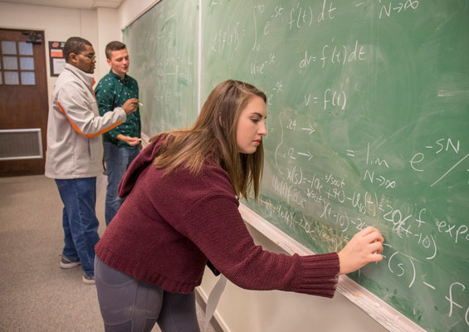
Meaningful Applications
Applications are meaningfully incorporated in a mathematics class to the extent that they support students in identifying mathematical relationships, making and justifying claims, and generalizing across contexts to extract common mathematical structure.

Slide 9
Meaningful Applications
Applications are meaningfully incorporated in a mathematics class to the extent that they support students in identifying mathematical relationships, making and justifying claims, and generalizing across contexts to extract common mathematical structure.

Slide 10
Meaningful Applications
Applications are meaningfully incorporated in a mathematics class to the extent that they support students in identifying mathematical relationships, making and justifying claims, and generalizing across contexts to extract common mathematical structure.

Slide 11
Meaningful Applications
Applications are meaningfully incorporated in a mathematics class to the extent that they support students in identifying mathematical relationships, making and justifying claims, and generalizing across contexts to extract common mathematical structure.

Slide 12
Meaningful Applications
Applications are meaningfully incorporated in a mathematics class to the extent that they support students in identifying mathematical relationships, making and justifying claims, and generalizing across contexts to extract common mathematical structure.

Slide 13
Discussion of Meaningful Applications
Students identify mathematical relationships.
Students make an justify claims.
Students generalize across contexts.
Students extract common mathematical structure.
Notes:
Audience contributes their thoughts on the benefits and mechanisms for each of these elements of meaningful applications:
Benefits = Why are each of these things helpful?
Mechanisms = How do they support the learning process?

Slide 14

Academic Success Skills
Academic success skills foster students’ construction of their identity as learners in ways that enable productive engagement in their education and the associated academic community.

Slide 15
Academic Success Skills
Academic success skills foster students’ construction of their identity as learners in ways that enable productive engagement in their education and the associated academic community.

Slide 16
Academic Success Skills
Academic success skills foster students’ construction of their identity as learners in ways that enable productive engagement in their education and the associated academic community.

Slide 17
Academic Success Skills
Academic success skills foster students’ construction of their identity as learners in ways that enable productive engagement in their education and the associated academic community.

Slide 18
Academic Success Skills
Academic success skills include
a growth mindset
problem-solving and critical thinking skills
a disposition toward productive struggle
and productive beliefs about mathematics.

Slide 19
Discussion of Academic Success Skills
Students construct identities as learners.
Students’ identities enable productive engagement in their education.
Students’ identities enable productive engagement in academic community.
Academic success skills include a growth mindset, problem-solving and critical thinking skills, a disposition toward productive struggle, and productive beliefs about mathematics.
Notes:
Audience contributes their thoughts on the benefits and mechanisms for each of these elements of academic success skills:
Benefits = Why are each of these things helpful?
Mechanisms = How do they support the learning process?

